Slide 1
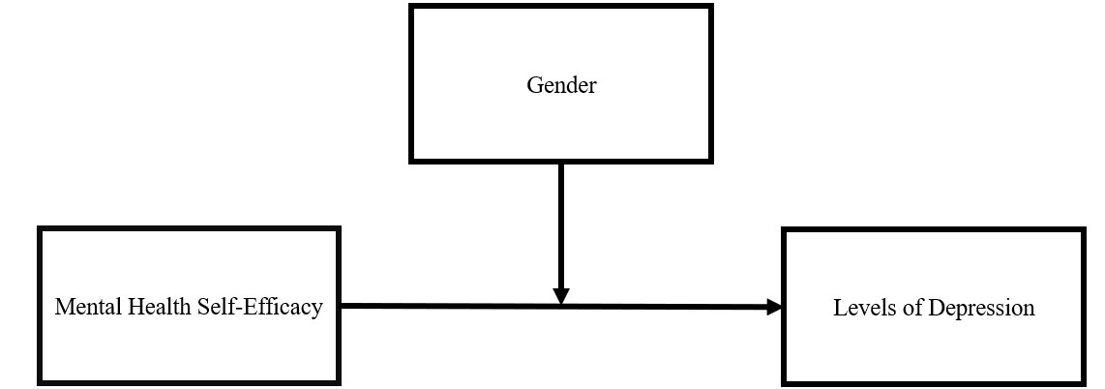
Self-Efficacy & Perception of Mental Well-Being
S. L. H. Capen-Becerra, A. Danzig, S. Louis, G. Olimpia Sansone
Introduction
Results
Discussion
When young adults have high self-efficacy, they tend to exhibit more resilience to stress and other mental health problems (King et al., 2014)
Self-efficacy is defined as the belief in one’s ability to succeed situations (Bandura, 1995).
Gender disparities in depression, from diagnoses to symptomology, is a widely researched topic (Genuchi, 2015).
Previous literature has shown than women tend to have higher levels of depression compared to men (Halbreich & Kahn, 2007). However, there is a potential gender bias in current diagnostic criteria in depression scales (Martin et. al, 2013).
Previous literature has found a link between self-efficacy and depression with a higher level of self-efficacy associated with lower levels of depression (Soysa & Wilcomb, 2015).
Hypotheses
Frequency of self-report depressive symptoms will not differ by gender.
Higher sense of self-efficacy will be associated with lower depressive symptoms.
The relationship between mental health self-efficacy and depressive symptoms will be stronger for women compared to men.
A significant main effect was found between mental health self-efficacy and depression, 𝛽 = -.379 , SE = 1.203, p = .004, when controlling for gender. Higher levels of mental health self-efficacy was associated with lower levels of depression.
When the interaction between gender and mental health self-efficacy was added to the model, there was no longer a significant main effect, There was not a significant main effect found between gender and depression, 𝛽 = -.439, SE = 1.384, p = .081.
A hierarchical linear regression demonstrated there was not a significant interaction between gender and depression, 𝛽 = -.262, SE = 2.420, p = .299.
Men (M = 7.828, SD = 5.645) did not show a significant difference in depression symptoms compared to other genders (M = 11.038, SD = 5.188).
Self-Efficacy
Our results support previous research showcasing the negative relationship between self-efficacy and rates of depression (Lopez-Garrido, 2020) but only before the interaction with gender was included in the model.
Gender and Depression
The findings support the hypothesis of a gender bias in previously used depression scales (Martin et al., 2013).
These results suggest there may not be a significant difference in depression rates among genders, as previously indicated by the literature (Nolen-Hoeksema, 1999)
Future Implications
This study demonstrates that potential interventions surrounding mental health self-efficacy may successfully reduce depression in college-aged students.
The limitations within our study include a homogeneous sample size as well as a lack of power, causing limited capabilities to generalize results. As such, future research should build upon our study by focusing on a larger, heterogeneous, sample size to examine if gender is truly a moderator for self-efficacy and depression.
Figure 1
Moderation Conceptual Model
Method
Participants
N = 58 undergraduate psychology students
Gender, identity, and age was collected.
Participants received course credit for completion.
Measures
IV : Self-efficacy, measured by using a survey questionnaire taken from the 2018 National Survey of Health Attitudes.
DV: Depression, measured by utilizing the Gender Inclusive Depression Scale (GIDS; Marten et al., 2013).
Moderator: Gender, separated by men and all other.
Statistical Analyses
We ran descriptive stats for the participants demographic data, for IV (Mental Health Self-Efficacy), DV (Depressive Symptoms), and the Moderator (Gender).
We ran a linear regression testing the relationship between our IV & our DV.
We ran a moderation analysis using hierarchical linear regression.
References
Bandura, A. (Ed.). (1995). Self-efficacy in changing societies. Cambridge University Press. https://doi.org/10.1017/CBO9780511527692
Genuchi, M. (2015). Anger and hostility as primary externalizing features of depression in college men. International Journal of Men's Health. ​
Halbreich, U., & Kahn, L. S. (2007). Atypical depression, somatic depression and anxious depression in women: Are they gender-preferred phenotypes? Journal of Affective Disorders, 102(1-3), 245-258. https://doi.org/10.1016/j.jad.2006.09.023​
King, C. A., Wu, J., & Niiranjan, S. (2014). Social support, self-efficacy and depression of college students. International Journal of Arts and Social Science, 2(3), 51-64. ​
Lopez-Garrido, G. (2020, August 9). Self-efficacy theory. Self-Efficacy Theory | Simply Psychology. Retrieved April 3, 2022, from https://www.simplypsychology.org/self-efficacy.html
Martin, L. A., Neighbors, H. W., & Griffith, D. M. (2013). The experience of symptoms of depression in men vs women: analysis of the National Comorbidity Survey Replication. JAMA psychiatry, 70(10), 1100–1106. https://doi.org/10.1001/jamapsychiatry.2013.1985
Nolen-Hoeksema, S., Larson, J., & Grayson, C. (1999). Explaining the gender difference in depressive symptoms. Journal of Personality and Social Psychology, 77(5), 1061–1072. https://doi.org/10.1037//0022 -3514.77.5.1061
Soysa, C. K., & Wilcomb, C. J. (2015). Mindfulness, self-compassion, self-efficacy, and gender as predictors of depression, anxiety, stress, and well -being. Mindfulness, 6(2), 217-226. http://dx.doi.org/10.1007/s12671-013 -0247-1​
Table 1
Regression Results Predicting Depression

