Slide 1
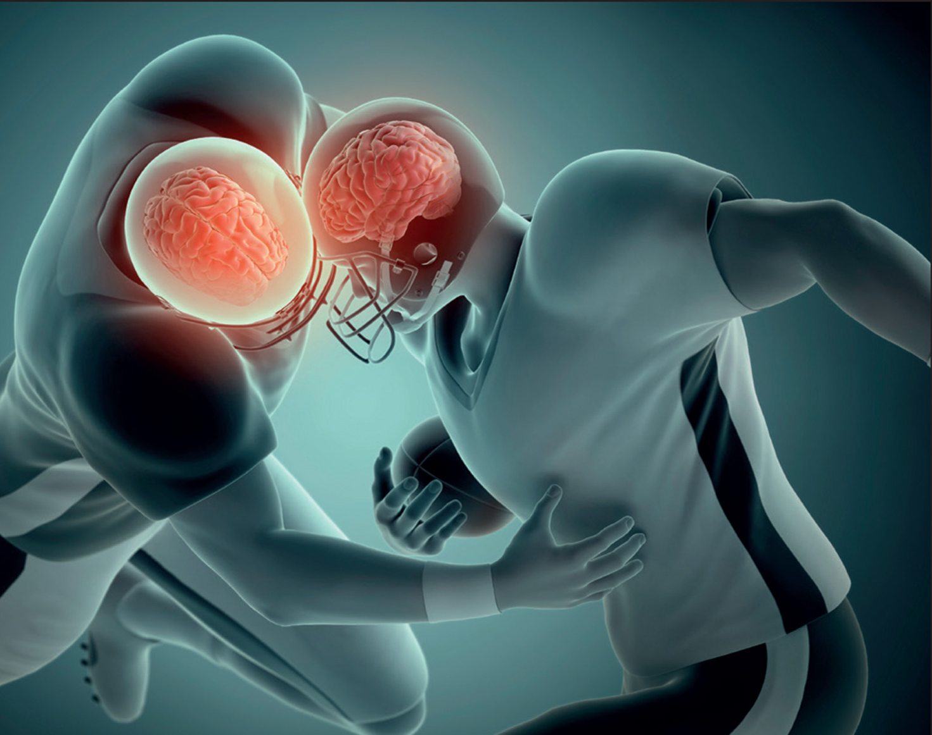
Evaluating the Effects of Concussions and tDCS on Executive Functioning in College Students
Erin Dychdala and Macey Hoffman
Neuroscience and Psychology
Mentor: The Wonderful Dr. Joel Bish
Notes:
https://momentumtherapy.ca/2023/10/30/integrating-chiropractic-care-in-concussion-management-a-holistic-approach-for-healthcare-providers/

Slide 2
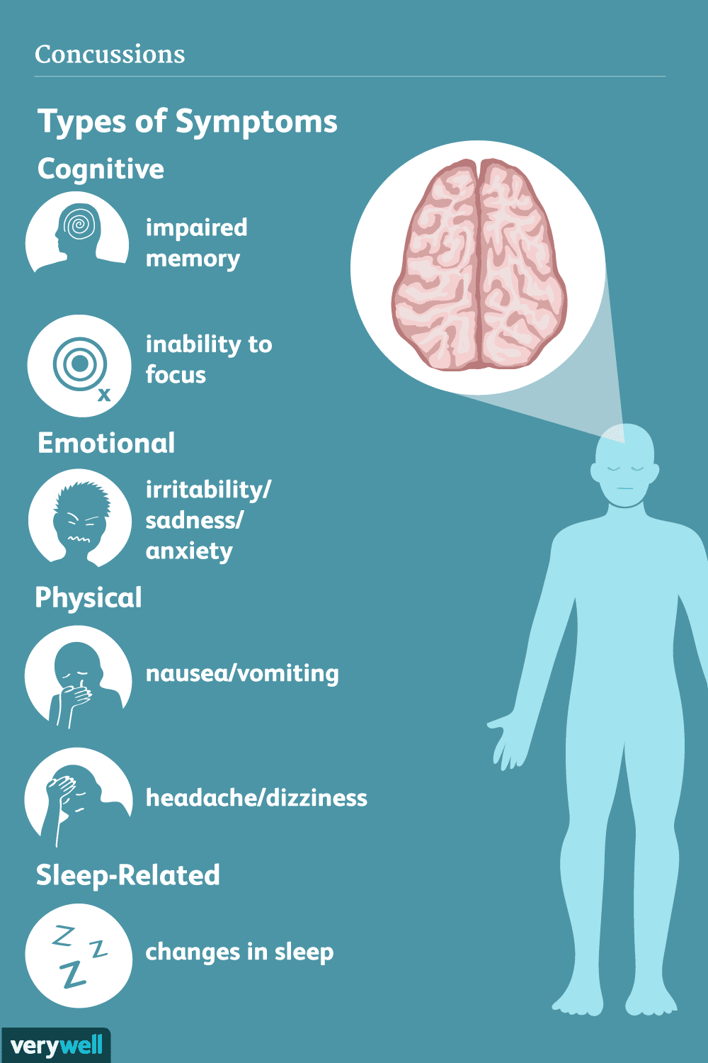
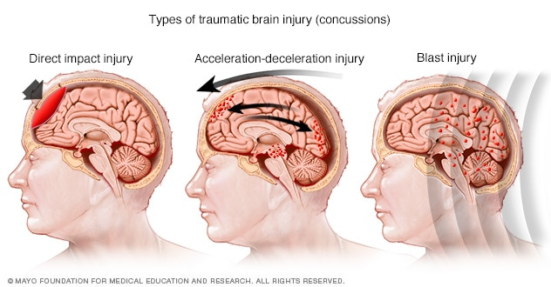
What are concussions?
Mild traumatic brain injury
~55.9 million cases annually
(“Estimating the Global Incidence of TBI • AMN • Academy for Multidisciplinary Neurotraumatology”)
Brain meets the skull
Short-term and long-term symptoms
Notes:
https://www.mayoclinic.org/diseases-conditions/concussion/symptoms-causes/syc-20355594,
https://brain-amn.org/global-incidence-of-tbi/#:~:text=In%20conclusion%2C%2069%20million%20people,suffer%20a%20severe%20TBI%20annually.
Concussions, also referred to as mild traumatic brain injuries occur when impact to the head causes the brain to contact the skull

Slide 3
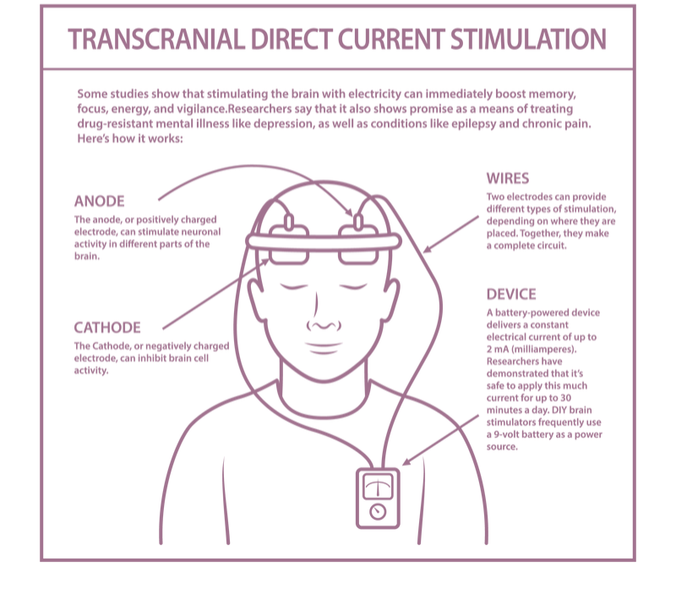
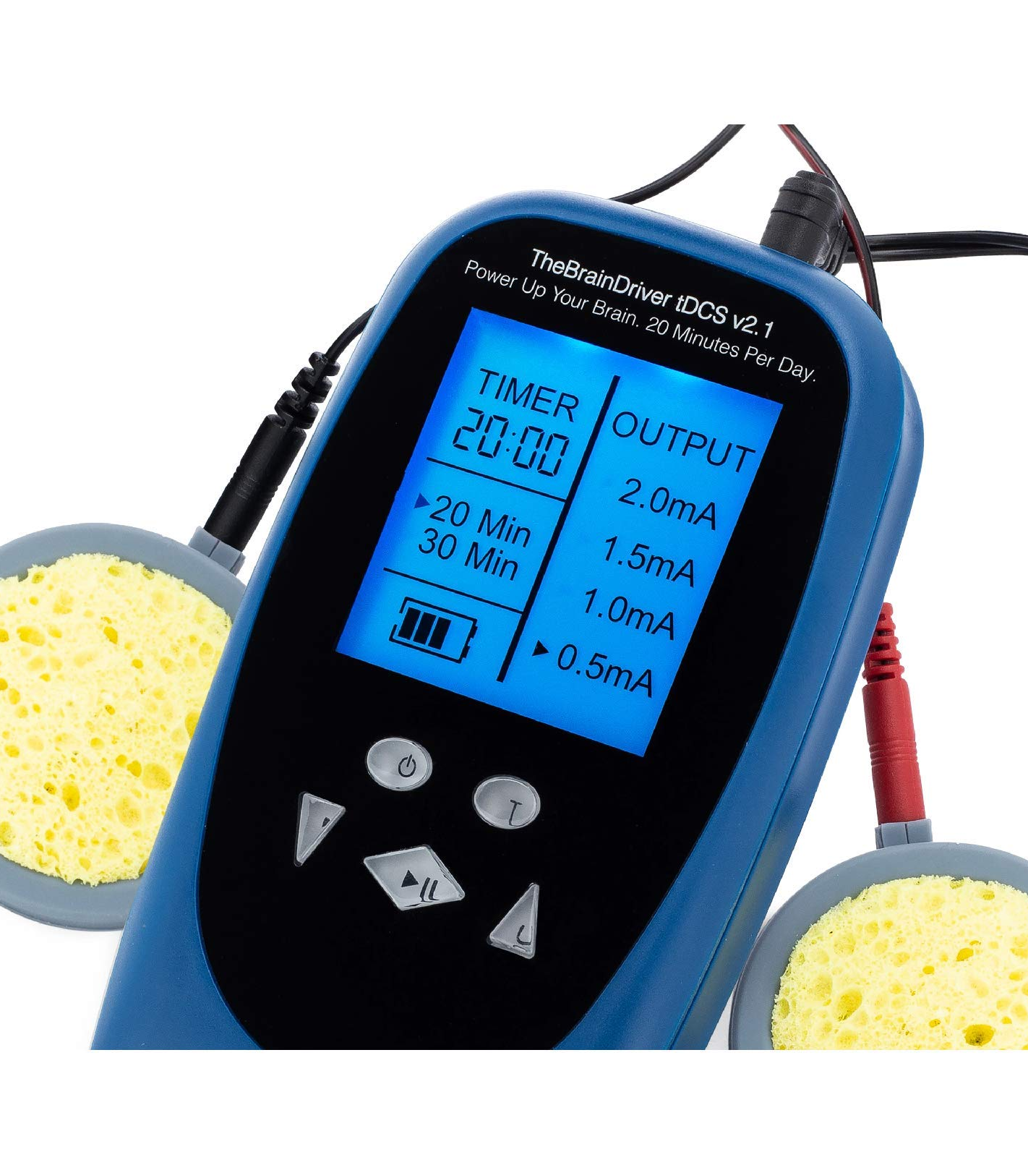
tDCS
Transcranial direct current stimulation
Notes:
https://www.neuraliatms.com.au/tdcs/, https://www.amazon.com/tDCS-Device-TheBrainDriver-Ready-Use/dp/B018AE2CV2

Slide 4
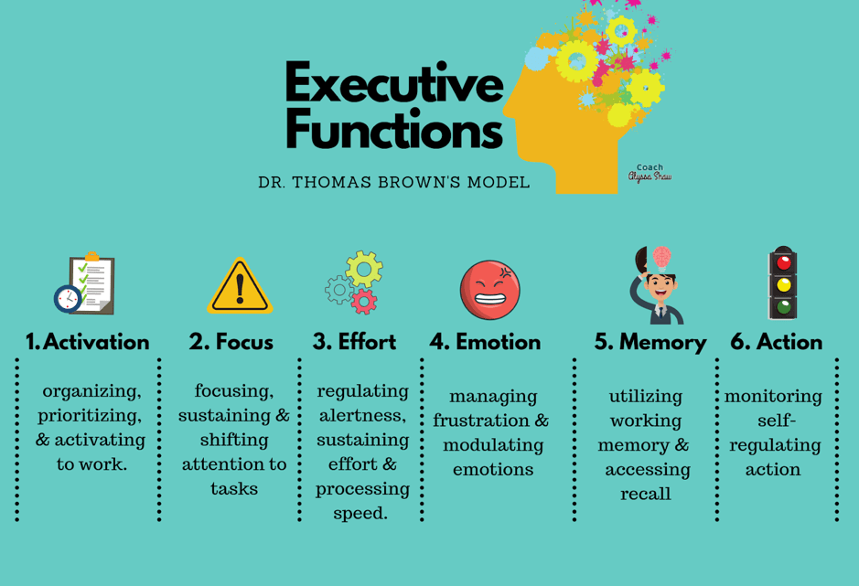
Hypothesis
We anticipate observing:
Variations in performance between non-concussed and concussed individuals
Variations between the tDCS and non-tDCS groups
Notes:
https://www.thesummitpsychology.com/blog/relationships-and-adhd

Slide 5
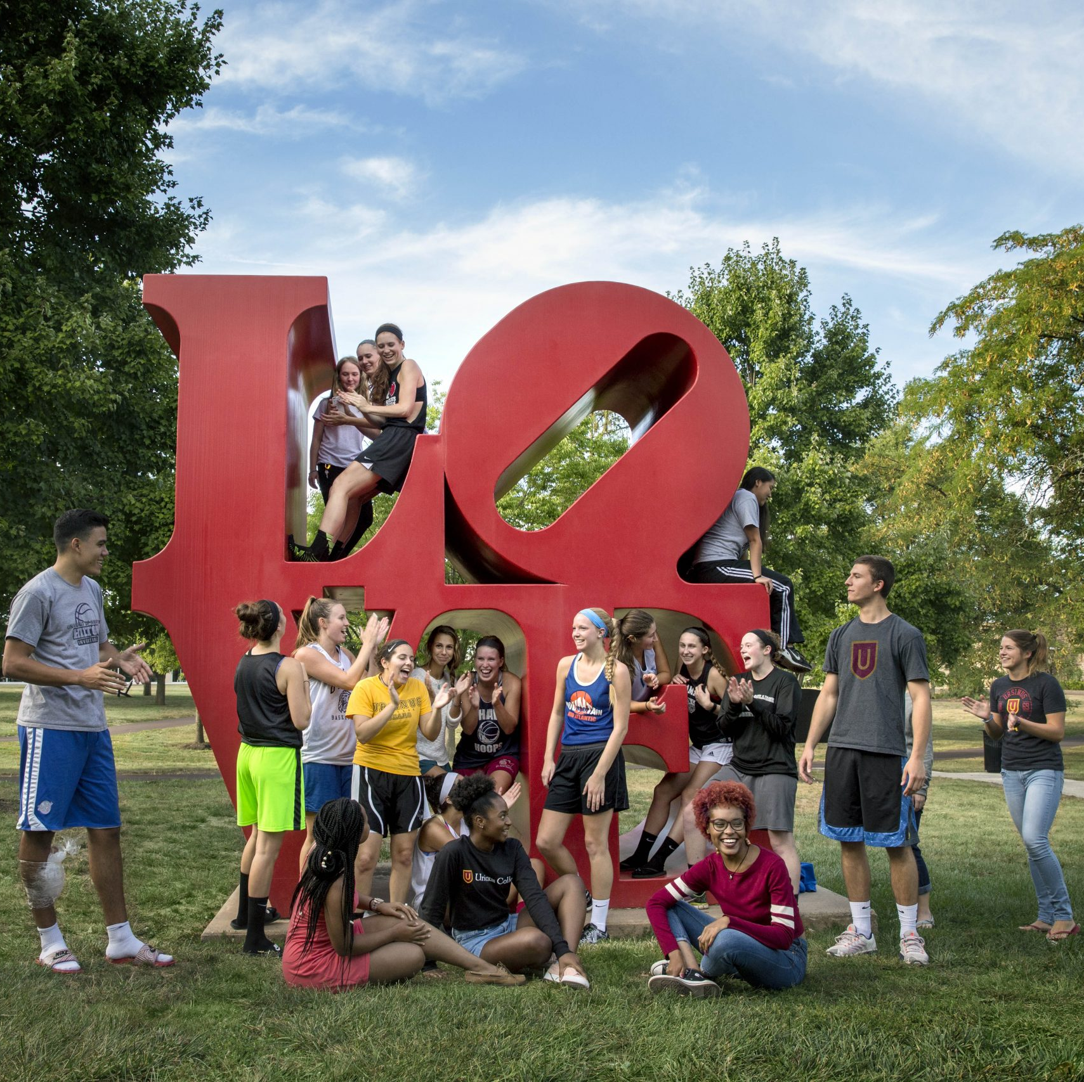
Sampling Survey and tDCS
Ursinus College Students
20 minutes at 1.5mA
https://www.google.com/url?sa=i&url=https%3A%2F%2Fctcl.org%2Fursinus-college%2F&psig=AOvVaw1iqm8SUaa1vaFNxex3Qb3G&ust=1721180310617000&source=images&cd=vfe&opi=89978449&ved=0CBEQjRxqFwoTCPCok8C2qocDFQAAAAAdAAAAABAK
Notes:
For convenience, our study sample was ursinus students ranging from 18-22 years old, both with and without a history of concussions. Each participant was asked to fill out a survey with questions regarding their general demographics and concussion history. During this time, the sponges of the tDCS were placed onto the forehead with the hope of stimulating the frontal lobe. Once 10 minutes past, the participant was asked whether they felt anything different than before they received the tDCS treatment

Slide 6
EEG and Tasks
Iowa Gambling
Hearts and Flowers
Tower of London
Framing
Stop Signal

Slide 7
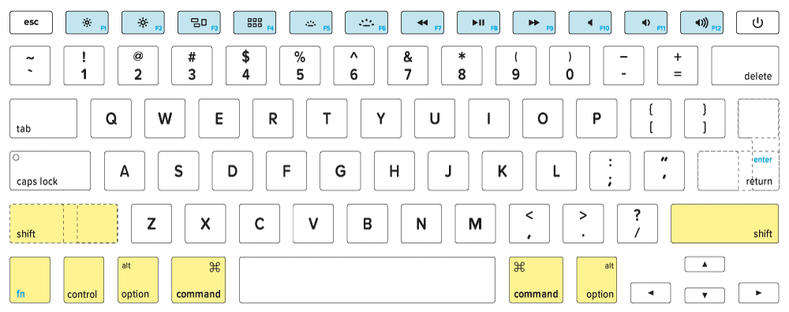
Hearts and Flowers Task

Slide 8
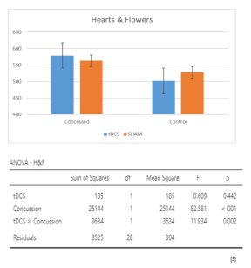
Behavioral: Hearts and Flowers
tDCS = faster reaction time (RT) in non-concussed
tDCS had no effect on concussed RT
Notes:
Improvements in non-concussed individuals who received tDCS in the combined trial of hearts and flowers. Switch trials (requires frontal lobe functioning), interaction between concussion status and tDCS (sig). Controls who got tDCS had a faster reaction time in the switching trials. tDCS did not significantly affect individuals with a history of concussions, indicating that more or longer tDCS treatments may be needed to make an impact, or that tDCS doesn’t work

Slide 9
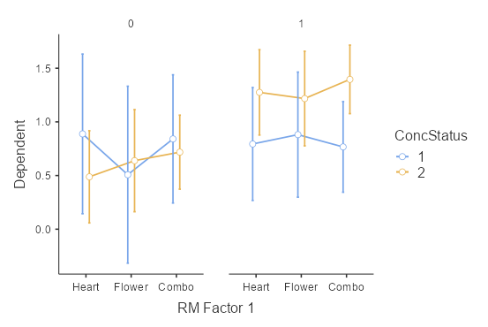
EEG: Hearts and Flowers
No tDCS
tDCS
Alpha/Beta Wave Ratio
Concussed
Control
Trial
Notes:
Lower Alpha/Beta ratio = lower relaxation/higher stress → SIGNIFICANT in combo trials of H&Fs
tDCS had no effect on A/B ratio of concussed
In non-concussed, tDCS correlated to an increased A/B ratio, so control were more relaxes than concussed in the combo/switching trials of H&Fs
Higher Beta/Theta ratio = decreased cognitive control → NOT significant for H&Fs
The combo trial interrogates the frontal lobe the most, and tDCS shows that it helps controls relax, but does not help concussed individuals.
Lower A/B and higher B/T ratios have been implicated in disorders such as ADHD and age-related cognitive decline.

Slide 10
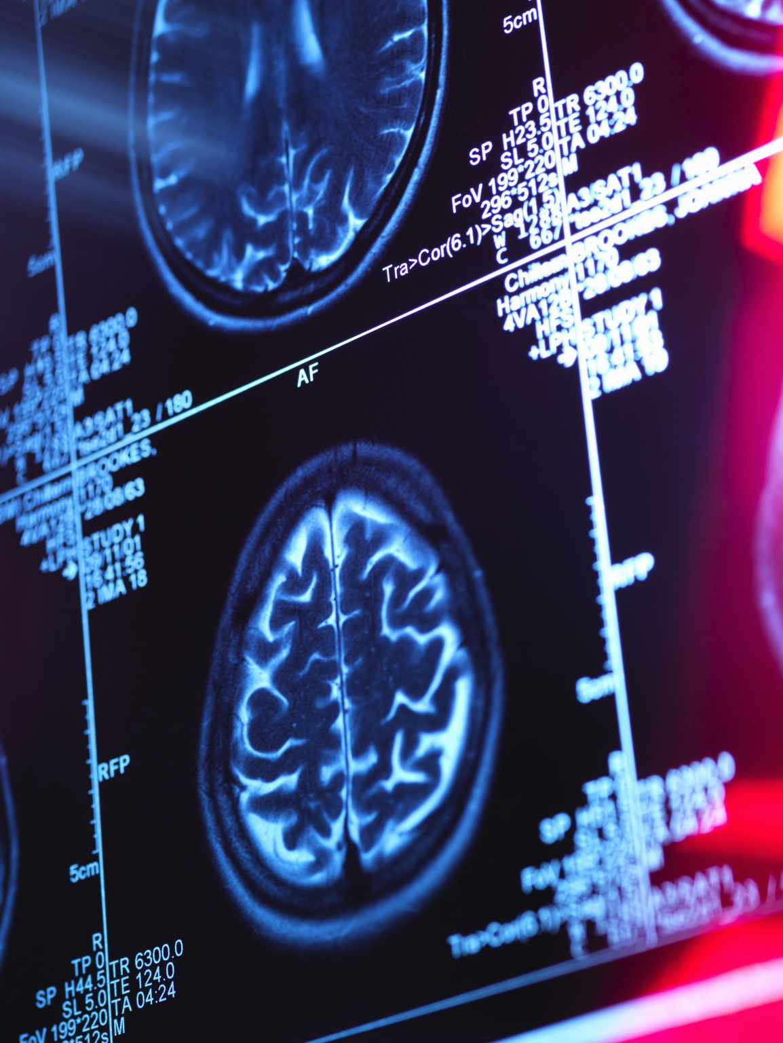
Conclusions
tDCS may have minor impacts on non-concussed
Differences between concussed and non-concussed
Is tDCS a placebo?
Significance of Beta wave ratios
Notes:
tDCS had no significant impacts on subjects with a concussion history, suggesting that if tDCS has the potential to be a valid treatment method, that longer or more trials of tDCS would be needed to make any noticeable impact. tDCS could also be more of a placebo effect. However, tDCS did seem to have mild impacts on non-concussed individuals, which suggests that it could be doing something. Lower A/B and higher B/T ratios have been implicated in disorders such as ADHD and age-related cognitive decline.

Slide 11
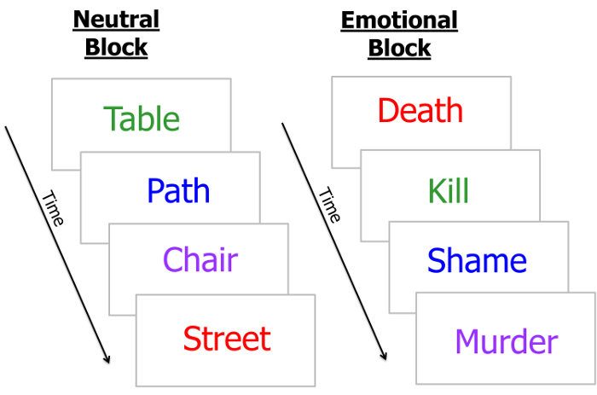
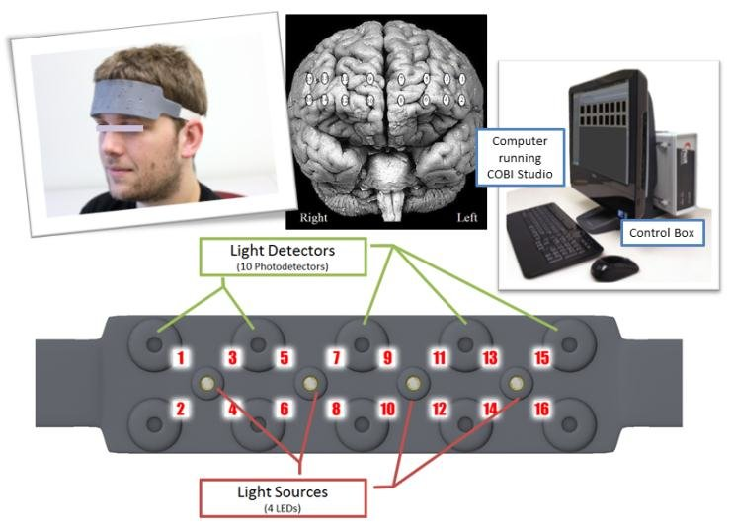
Next Steps
More or longer tDCS treatments
Sex differences
fNIR (functional near-infrared spectroscopy)
More accurate Tower of London task
Emotional Stroop task
Larger sample size
Notes:
In total, we only have data analyzed from about 35 Ursinus students, and though we do see some statistical deviances, a larger sample would offer a more accurate picture. At a p-value of 0.05, some of our data is significant, but at the same time, we have some data measures that are trending towards significance, and a larger sample size would help to pronounce these significances or not. Previous research shows that there are sex differences between male and female subjects. Female subject tend to exhibit greater impairments and take longer to recover than men, so a bigger sample size would also allow us to look at potential differences in long-term symptoms between male and female subjects.
Functional near-infrared spectroscopy (fNIRS) is a non-invasive brain imaging technique that measures blood oxygenation changes similar to fMRI. fNIR uses near-infrared light to measure oxygen concentration in different areas of the brain. The more active a part of the brain is, the more oxygen it needs. By using fNIR, we will be able to better and more specifically visualize differences in concussed vs non-concussed individuals while they complete cognitive tasks. We saw no significant data from our versions of the Tower of London test, but it is simplified from the original physical test, so we are hoping to find a more accurate version of that test for more specific results. Also, since framing was too similar to iowa gambling, we are planning to replace it with an emotional stroop test, which would allow us to observe emotional regulation.
https://www.researchgate.net/figure/fNIR-sensor-pad-that-measures-from-16-locations-over-the-forehead-and-system-overview_fig2_225273964, https://www.jove.com/t/53720/the-emotional-stroop-task-assessing-cognitive-performance-under

Slide 12
Acknowledgements
Mentor Dr. Bish
Ursinus College Psychology and Neuroscience departments
Students in Dr. Bish’s Lab
Notes:
We want to thank our faculty mentor Dr. Bish for providing training and guidance throughout our research study. We would also like to thank the neuro/psych departments for providing us with the necessary equipment to preform our study. Finally, we would like to thank the rest of the students in Dr. Bish’s lab for helping to collect our subject data throughout the fall and spring semesters and for helping with data analysis.

