Slide 1
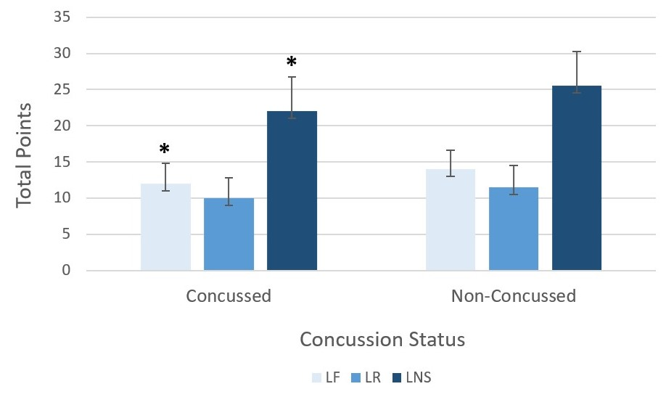
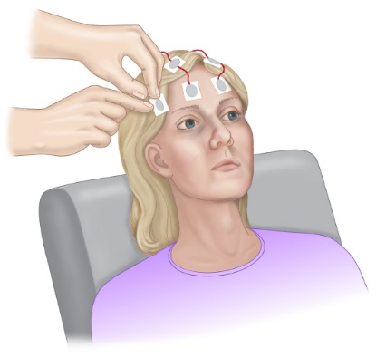
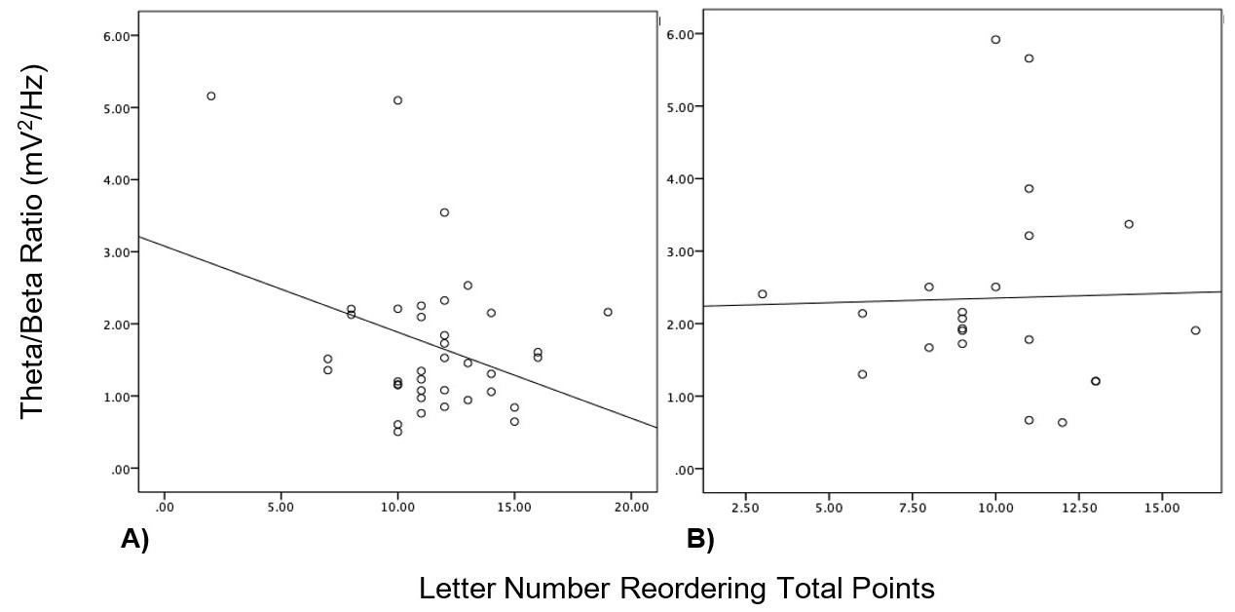
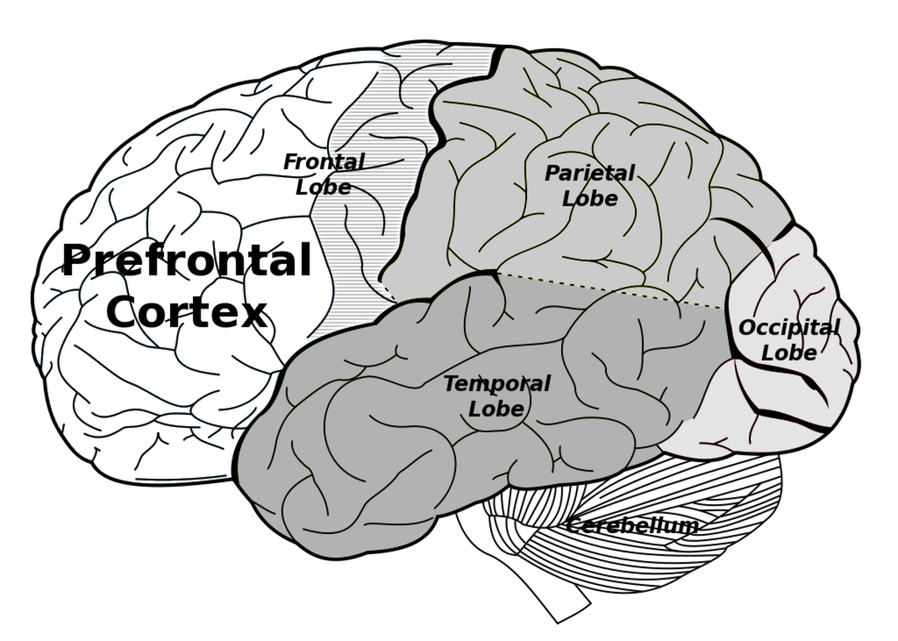
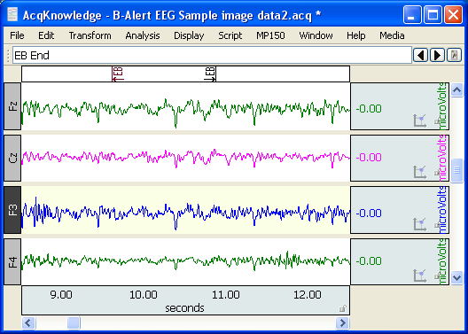
Variations in Slow-Wave EEG and Working Memory Deficits During Letter Number Sequencing Task Post-Concussion
By: Morgan Sotoloff
Mentor: Dr. Joel Bish
Department of Neuroscience/Psychology
Abstract
Method
Results
Conclusion
As the prevalence of sports related concussions rise, the long-term effects of concussions have garnered increasing research attention. Previous research has demonstrated that certain dimensions of executive function are especially susceptible to mild traumatic brain injury (mTBI), specifically working memory and attention. Previous studies using electroencephalography (EEG) have found that increased very low frequency oscillations (VLFO) disrupt goal-oriented activities and are associated with difficulties in cognition, hyperactivity, and inattention in concussed individuals after mTBI. This study utilized continuous EEG during a letter number sequencing task on concussed and non-concussed individuals to assess deficits related to working memory and attention. It was hypothesized that concussed student athletes would display greater VLFO and decreased accuracy during the Millisecond Letter Number Sequencing Task. Results of this study showed evidence of a significant increase in the theta/beta ratio during the letter number reordering span in concussed individuals as well as shorter forward and overall span. This study concluded that individual's post-concussion show altered activity within the frontal lobe region during working memory tasks.
Concussion Status | Participants | Age | Months Since Concussion
Concussed | N = 22 | M = 19.18 SD = 0.95 | M = 45.91 SD = 33.27
Non-concussed | N = 37 | M = 19.48 SD = 1.26 | N/A
Concussed individuals performed significantly worse overall on the LNS task and showed variances among theta/beta ratios through the duration of the task.
Concussions negatively impact executive function causing deficits to various complex cognitive processes.
Inappropriate elevation of theta/beta power has previously been found to be positively correlated with inattention (Putman, 2014).
Similar findings indicated that variances among theta/beta power may be indicative of a compensation mechanism due to post-concussive damage (Balkan, 2015).
Concussed individuals displayed a similar inability to activate and modulate working memory during increasing difficulty of an n-back test (McAllister, 2006).
Further research should utilize other working memory tasks, pre-season baseline testing, and a larger sample size to establish a relationship between the variances in EEG waves and executive function deficits.
This study provides evidence of the application of EEG as a sufficient neuroimaging technique for assessing mTBI.
Figure 1. Concussed individuals performed worse on forward span recall (LF) and the overall letter number reordering (LNS) task. Concussed and non-concussed participants were given three trials of each increasing span size for a letter number forward and letter number reordering condition. If the participant failed twice, the test was concluded. Total points indicate advancement into each task and combined to calculate total LNS completion. LF bars: Concussed individuals performed significantly worse. * p = .001, LR bars: Concussed individuals trended towards worse performance, but was not significantly worse. p = 0.58, LNS bars: Concussed individuals performed significantly worse than non-concussed individuals on the LNS task overall. *p = .008.
Introduction
References
Concussions are one of the most prevalent sports related injuries and can cause significant cognitive impairment.
The duration of symptomatology after suffering from a mTBI is variable for both acute and long-term effects.
The frontal lobe of the brain is responsible for many complex activities concerned with planning, problem solving, decision making, attention, impulse control and memory; all fall under the umbrella of “executive functioning.”
Long-term deficits associated with executive function have been previously found to linger up to three years post-concussion (Skandsen et al., 2010; Halterman et al., 2005)
Inefficiency in allocating attentional resources has been shown to impact processing speed and accuracy in tasks that test working memory (Broglio, 2009; Chan, 2001; Ozen 2013)
Balkan O, Virji-Babul N, Miyakoshi M, Makeig S, Garudadri H. Source-domain spectral EEG analysis of sports-related concussion via measure projection analysis. Annu Int Conf IEEE Eng Med Biol Soc. 2015; 4053-4056
Bohnen NL, Jolles J, Twijnstra A. Neuropsychological deficits in patients with persistent symptoms six months after mild head injury. J Neurosurg. 1992; 30(5): 692-696
Broglio SP, Pontifex MB, O'Connor P, Hillman CH. The persistent effects of concussion on neuroelectric indices of attention. J Neurotrauma. 2009; 26(9): 1463 1470
Chan RC. Attentional deficits in patients with post-concussion symptoms: a componential perspective. Brain Injury. 2001; 15(1): 71-94
Halterman CI, Langan J, Drew A, Rodriguez E, Osternig LR, Chou LS, et al. Tracking the recovery of visuospatial attention deficits in mild traumatic brain injury. Brain. 2005; 129(3): 747-753
McAllister TW, Flashman LA, McDonald BC, Saykin AJ. Mechanisms of working memory dysfunction after mild and moderate TBI: evidence from functional MRI and neurogenetics. J Neurotrauma. 2006; 23(10): 1450-1467
Ozen LJ, Itier RJ, Preston FF, Fernandes MA. Long-term working memory deficits after concussion: electrophysiological evidence. Brain injury. 2013; 27(11): 1244-1255
Putman P, Verkuil B, Arias-Garcia E, Pantazi I, Van Schie C. EEG theta/beta ratio as a potential biomarker for attentional control and resilience against deleterious effects of stress on attention. Cogn Affect Behav Neurosci. 2014; 14(2): 782-791
Skandsen T, Finnanger TG, Andersson S, Lydersen S, Brunner JF, Vik A. Cognitive impairment 3 months after moderate and severe traumatic brain injury: a prospective follow-up study. J Phys Med Rehabil. 2010; 91(12):1904-1913
r = -.34
r = .2
Item Correct Response
LNF – Forward Span 9-A-6-J-3-P 9-A-6-J-3-P
LNR – Reordering E-1-R-8-M-7 1-7-8-E-M-R
LNS Total = Forward Span Score + Reordering Span Score
mTBI incident
Figure 2. Relationships between theta/beta ratio and reordering performance in non-concussed (A) and concussed (B) individuals. Participants were tasked with reordering a random string of numbers and letters into ascending numerical order and alphabetical order while under continuous EEG monitoring. A) There is an inverse relationship present in non-concussed individuals. Greater attenuation of the very low frequency oscillations resulted in greater letter number task performance for individuals with no history of concussion, r = -0.34, p = .04. B) There was no observed relationship for attenuation of the very low frequency oscillations for any performance level in concussed individuals, r = 0.2, p > .05.
Long-term Effects
Acute Effects
Acknowledgements
Working memory deficits
(e.g. delayed memory)
Attentional deficits (e.g. inattention)
I would like to extend my gratitude to all members of Dr. Bish’s lab for their help in data collection. I am also grateful for the Psychology and Neuroscience department of Ursinus College for providing the funds to make this study possible. Lastly, I would like to thank Dr. Joel Bish for his aid and mentorship throughout the entire course of this project.
Overall executive function deficits
(e.g. poor decision making, risk taking)

