Slide 1
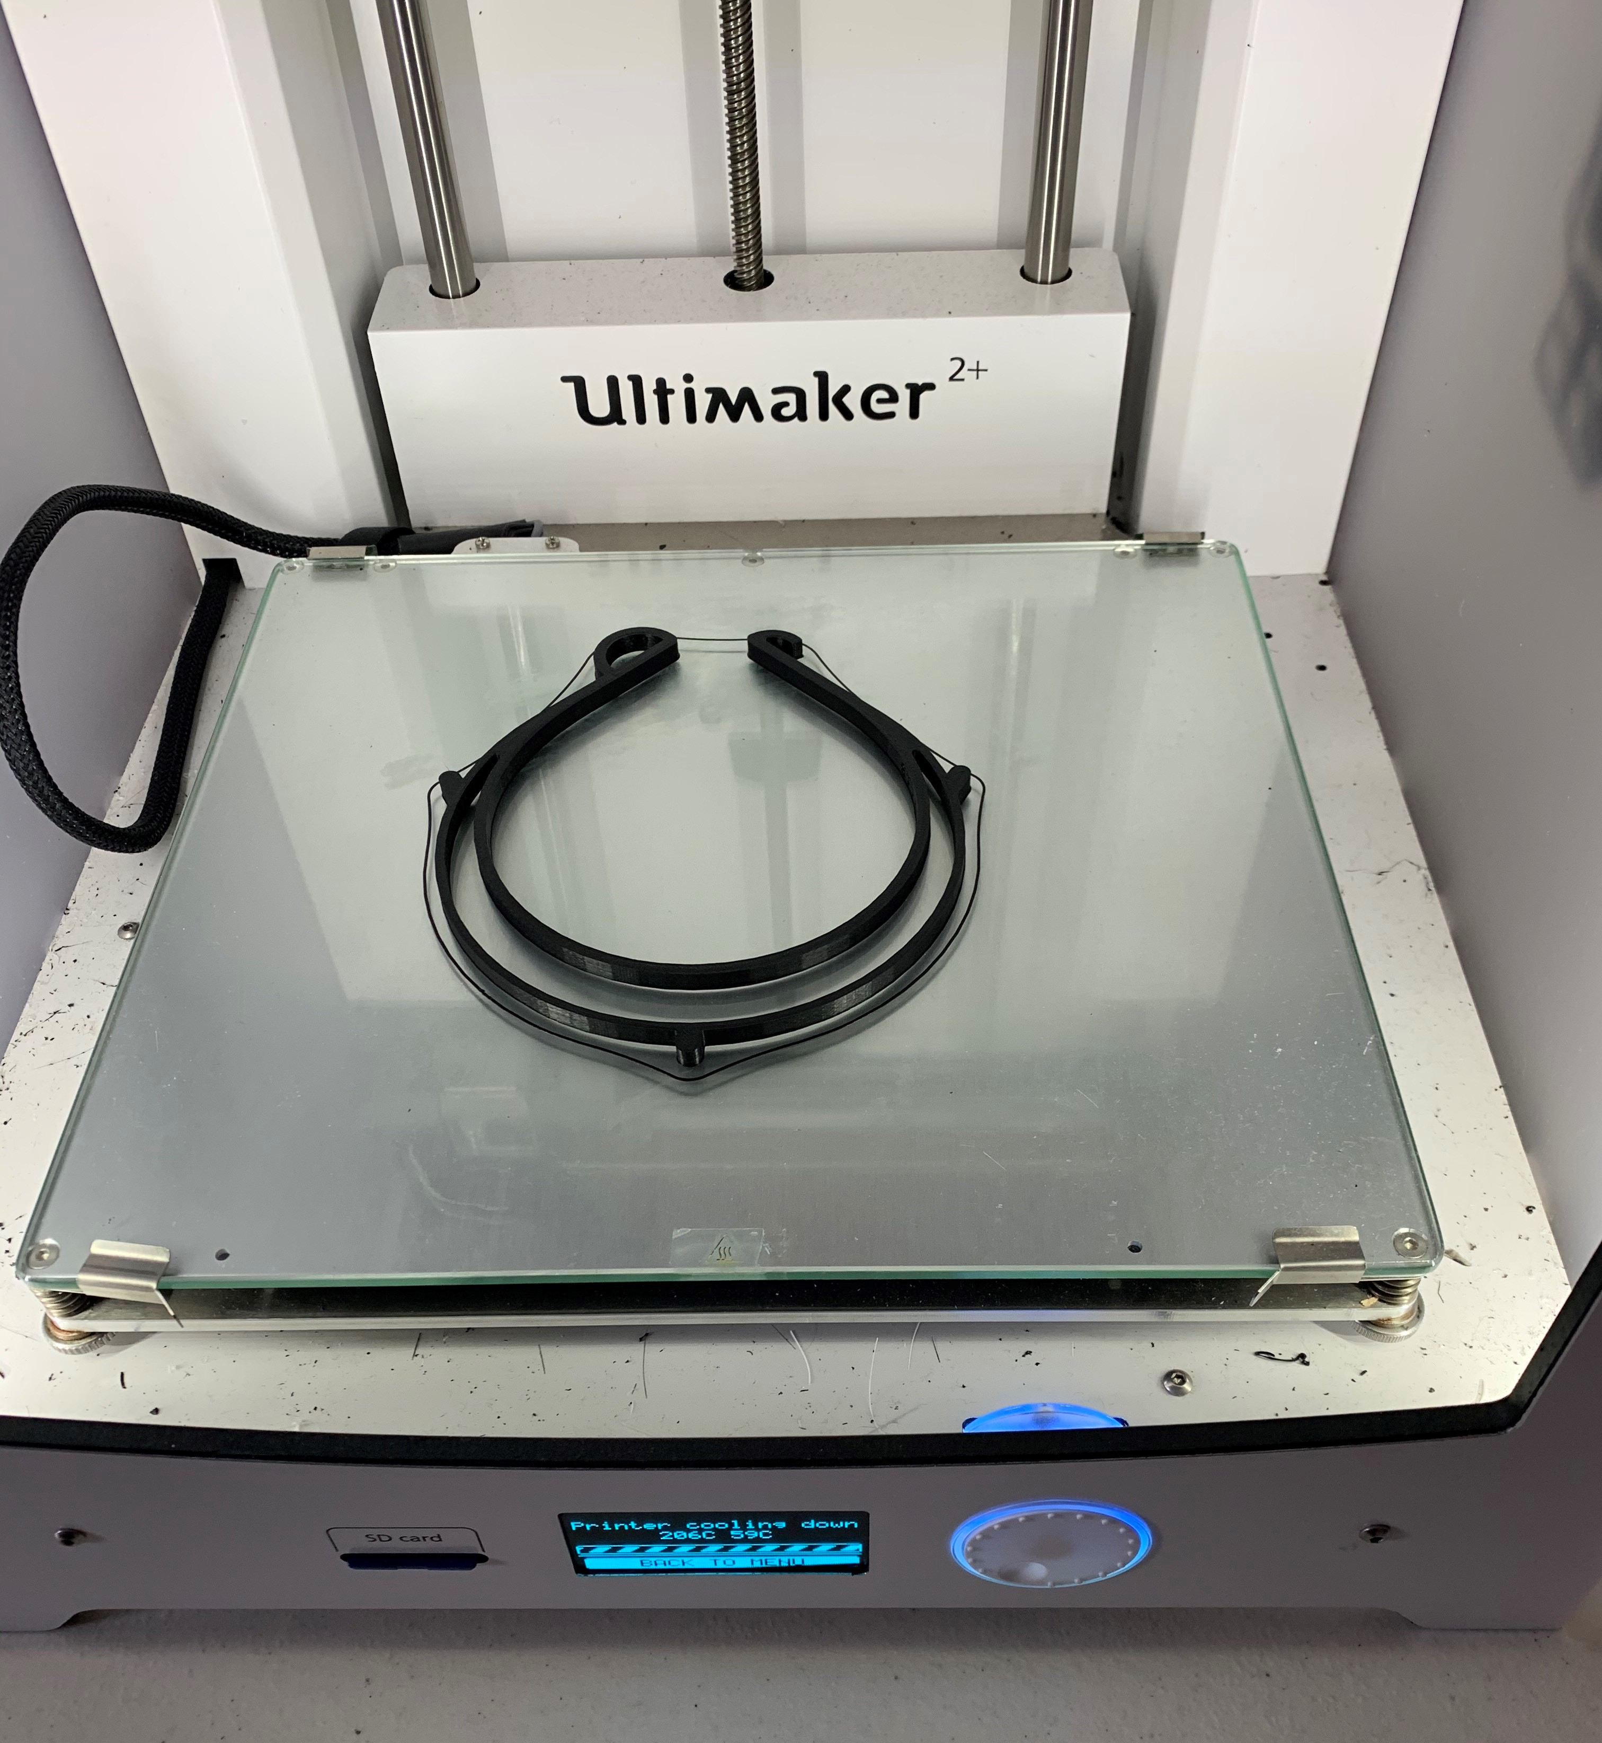
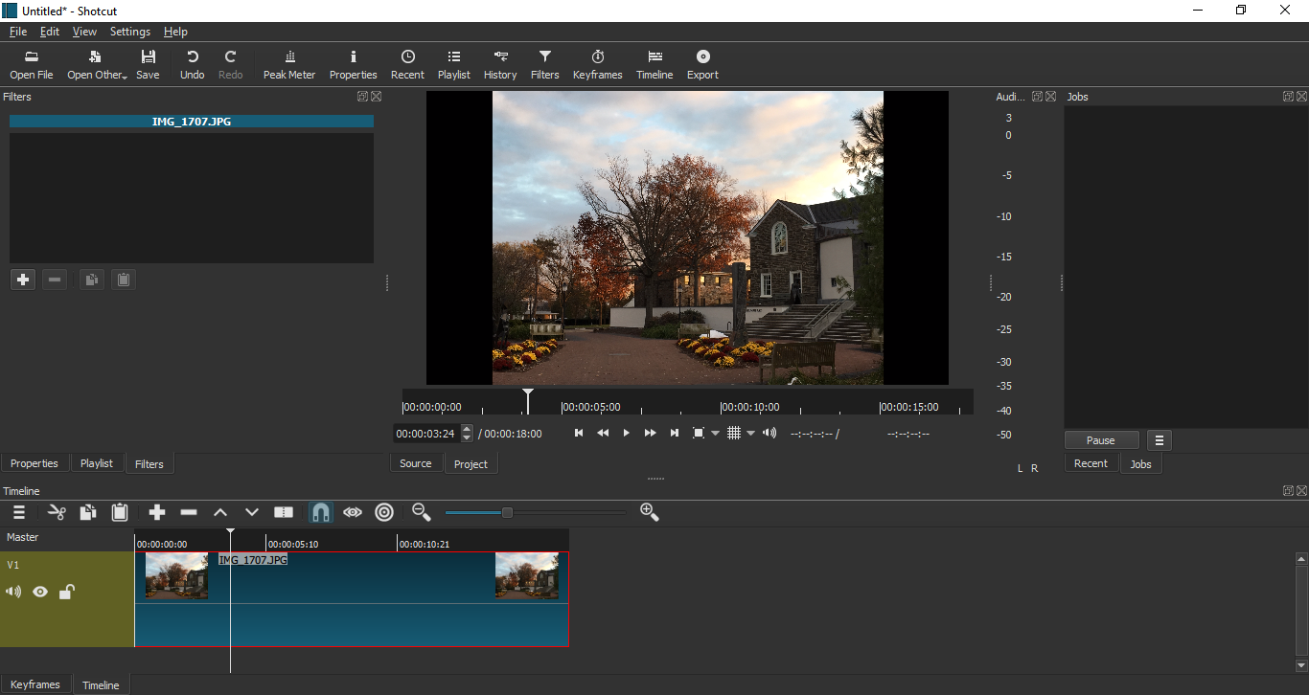
Digital Liberal Arts Fellows
What We Do
What We Have Been Up To
DLA Fellows work with students and faculty to incorporate digital projects into the classroom as well as teach people how to use digital technologies.
3D Printing in Association with the U-Imagine Center
Workshops
Audacity
3D Printing
Video Editing
Virtual Consultations
Leading Class Workshops
Assist with Library and IT Escape Rooms
Supported Technology
Audacity - Podcasting
Shotcut- Video Editing
Wordpress- Blogging
Storymap & Timeline JS
Powerpoint Recording
Omeka- Curation
Sway - Presentations
Canvas ePortfolios
Office 365
Ultimaker 3d Printer
Acknowledgements
A special thanks to Christine Iannicelli, the Library, and IT for making the DLA Fellows program possible.
Shotcut

