Slide 1
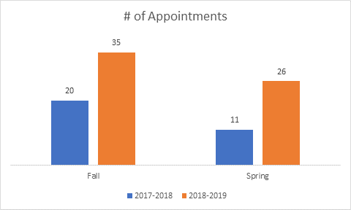
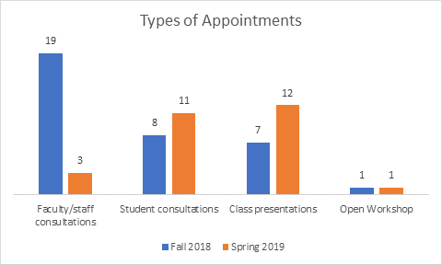
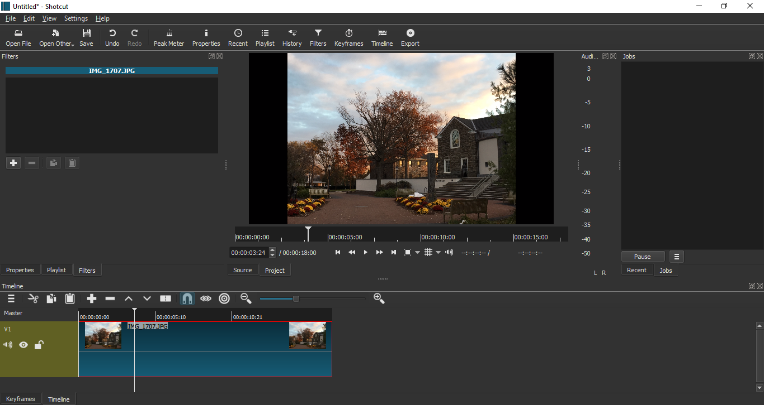
Digital Liberal Arts Fellows
What We Do
Statistics
Reflections
DLA Fellows work with students and faculty to incorporate digital projects into the classroom as well as teach people how to use digital technologies.
“Working as a DLA Fellow has helped give me a direction for my career after college. I discovered that digital technology can be used to make learning about history easier and fun.”
-Tiffini Eckenrod
Future Goals
Supported Technology
“This opportunity has allowed me to work first hand in creating interdisciplinary scholarship as well as guiding other students in doing the same. My eyes have been opened in the ways the humanities and the sciences can collaborative work together to interact and engage their audience in research.”
- Shelby Carmichael
Some of our future goals include focusing more on virtual reality and 3D printing. We also want to host workshops that will teach people how to use specific programs.
Audacity - Podcasting
Shotcut- Video Editing
Wordpress- Blogging
Storymap & Timeline JS
ArcGIS- Mapping
Omeka- Curation
Sway - Presentations
Canvas ePortfolios
Plus much more!
Example
Acknowledgements
A special thanks to Christine Iannicelli and Kara McShane, our supervisors and trainers. We would also like to thank the Dean’s Office and the Library for making the DLA Fellows program possible.

