Slide 1
Exploration of the Ursinus Food Forest Outreach Team
Presenting the Work of the 2020-2021 Food Forest Outreach Team
Victoria Bearden
Environmental Studies Department
Ursinus College

Slide 2
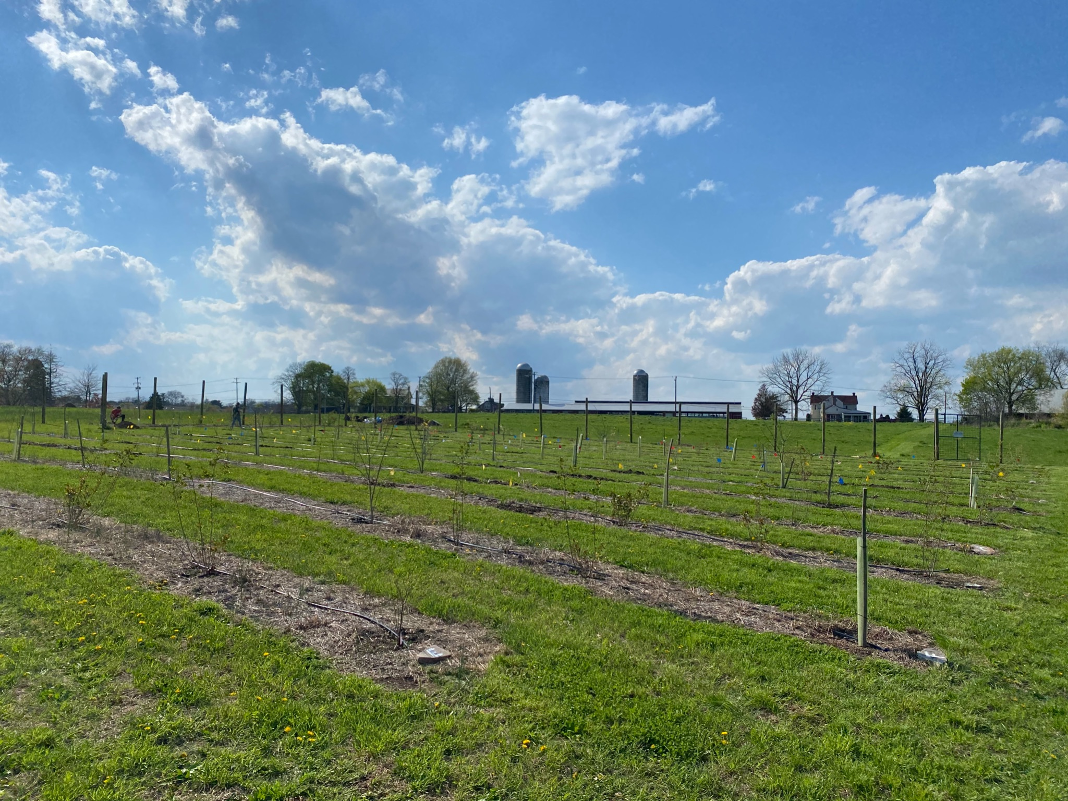
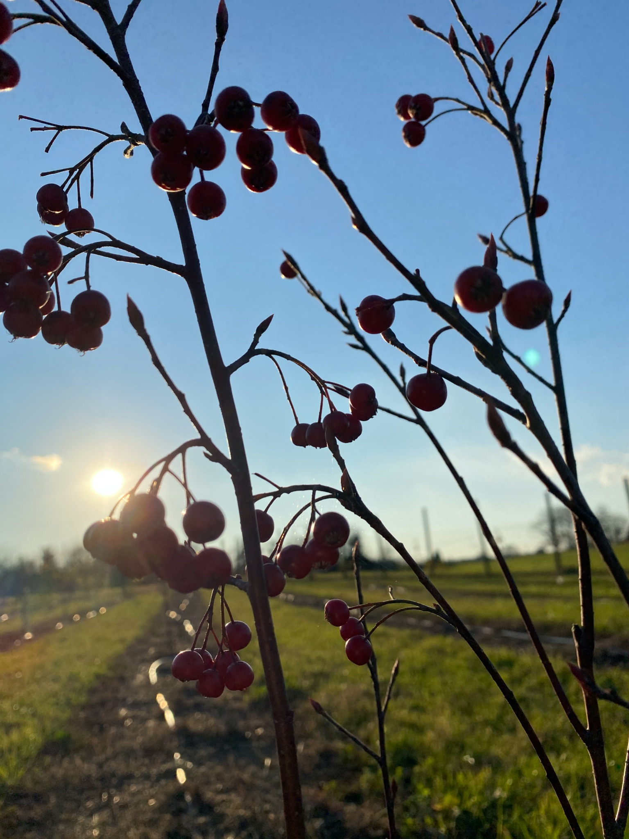
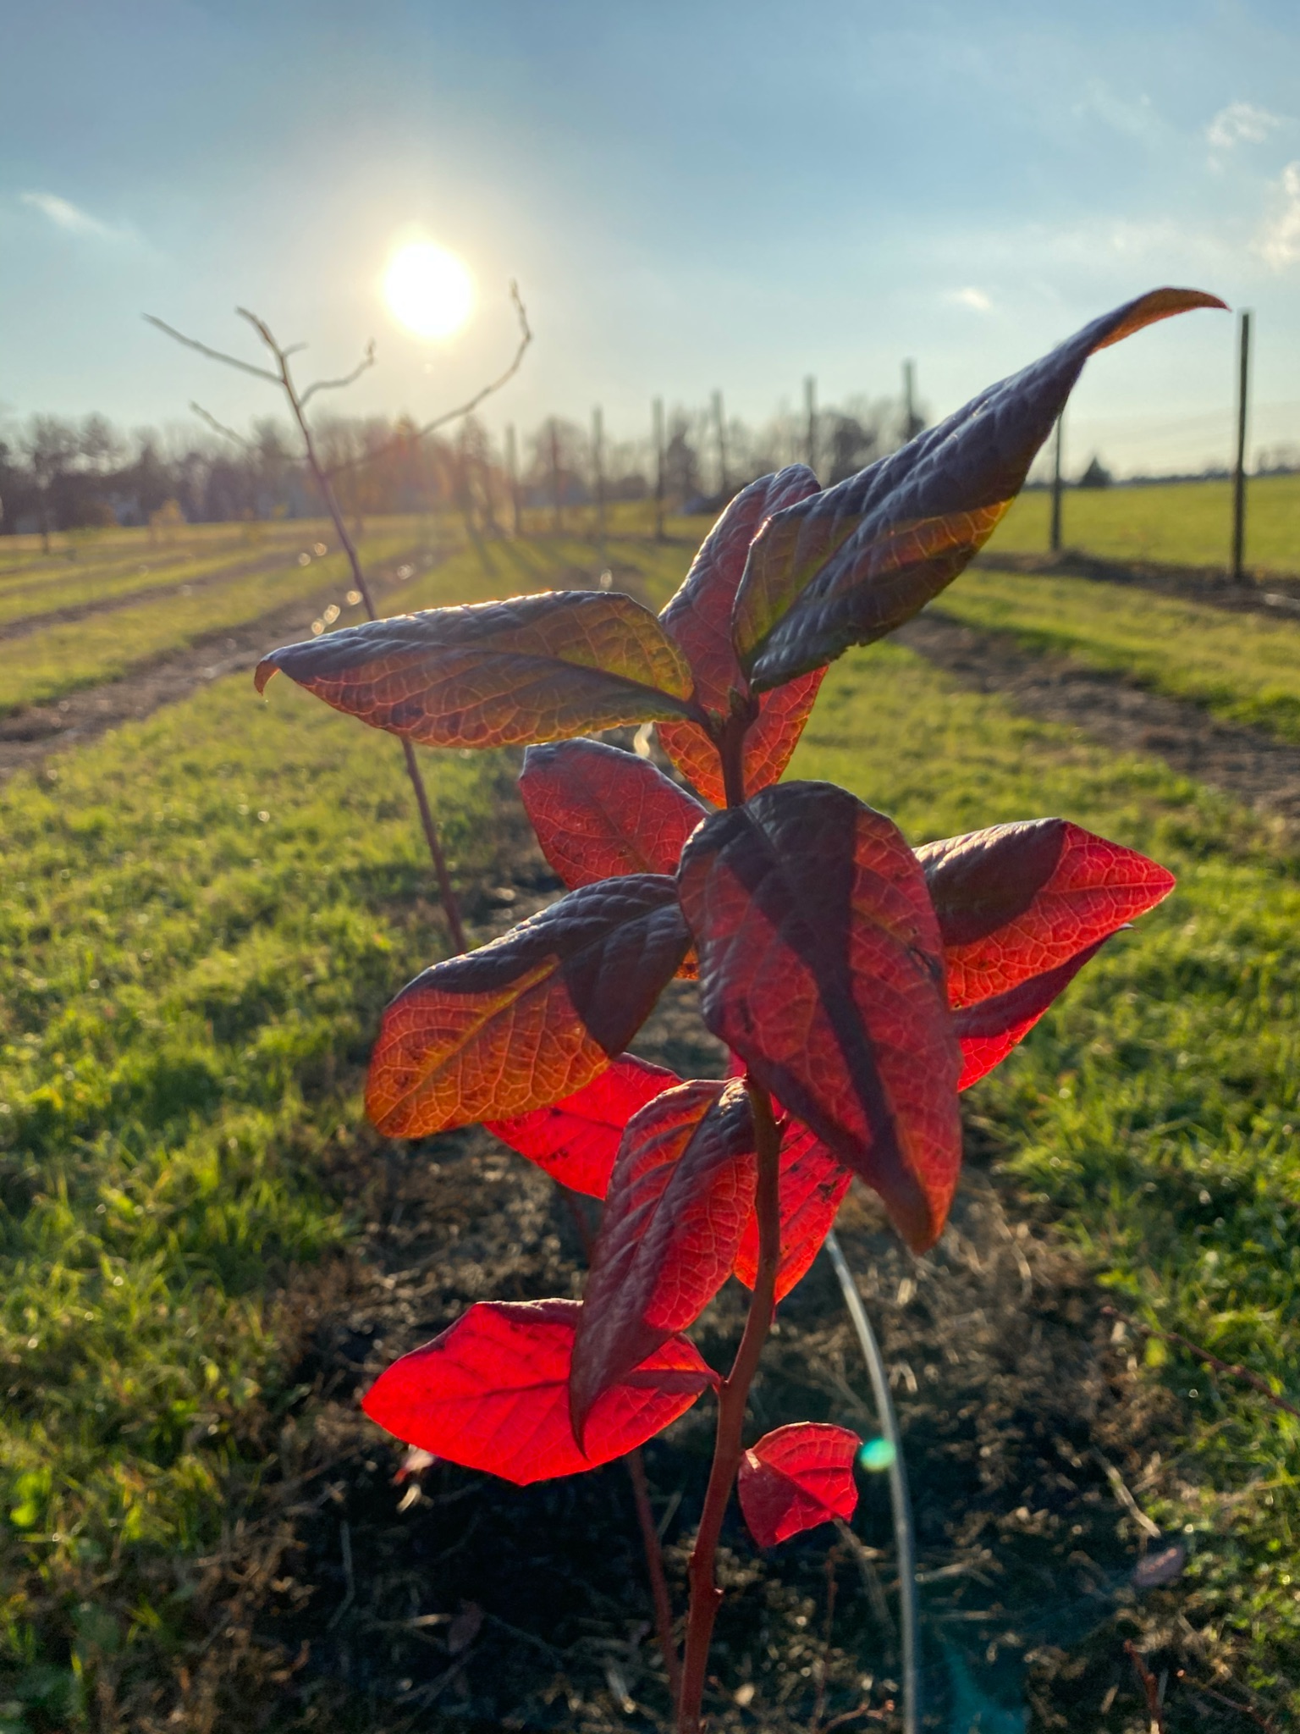
The Ursinus Food Forest
Located at Whittaker Environmental Research Station
Planted during Ursinus’ sesquicentennial
The first planting includes over 15 species of edible tree and shrubs
Allows students and the community to build relationships with the regions food producing and ecological beneficial native and non native plant species
Embraces lessons in urban agriculture, urban forestry, and agroforestry
Monitored by Dr. Patrick Hurley, student researchers, and Ursinus facilities

Slide 3
Guardians of the Food Forest
The Stewardship Team
The Outreach Team
Meet the Team
Stewardship Goals
Meet the Team
Outreach Goals
Cass Robinson
Amanda Paul
Lexi Fowler
Nate Berger
Jenny Ronzoni
Austin Mickles
Evan Stinson
Cara Vasso
Sarah Fisher
Tim Holzapfel
Natalie Jump
Victoria Bearden
Claire Parlee
Kristen Cooney
Addie Frey
Building a community around the Ursinus Food Forest
Create materials that will have a lasting impact for years to come
Develop protocols for future team members to use
Multiple site visits throughout the week to check on plant and site conditions
Perform stewardship activities that tend to plant health
Being involved as the food forest grows

Slide 4
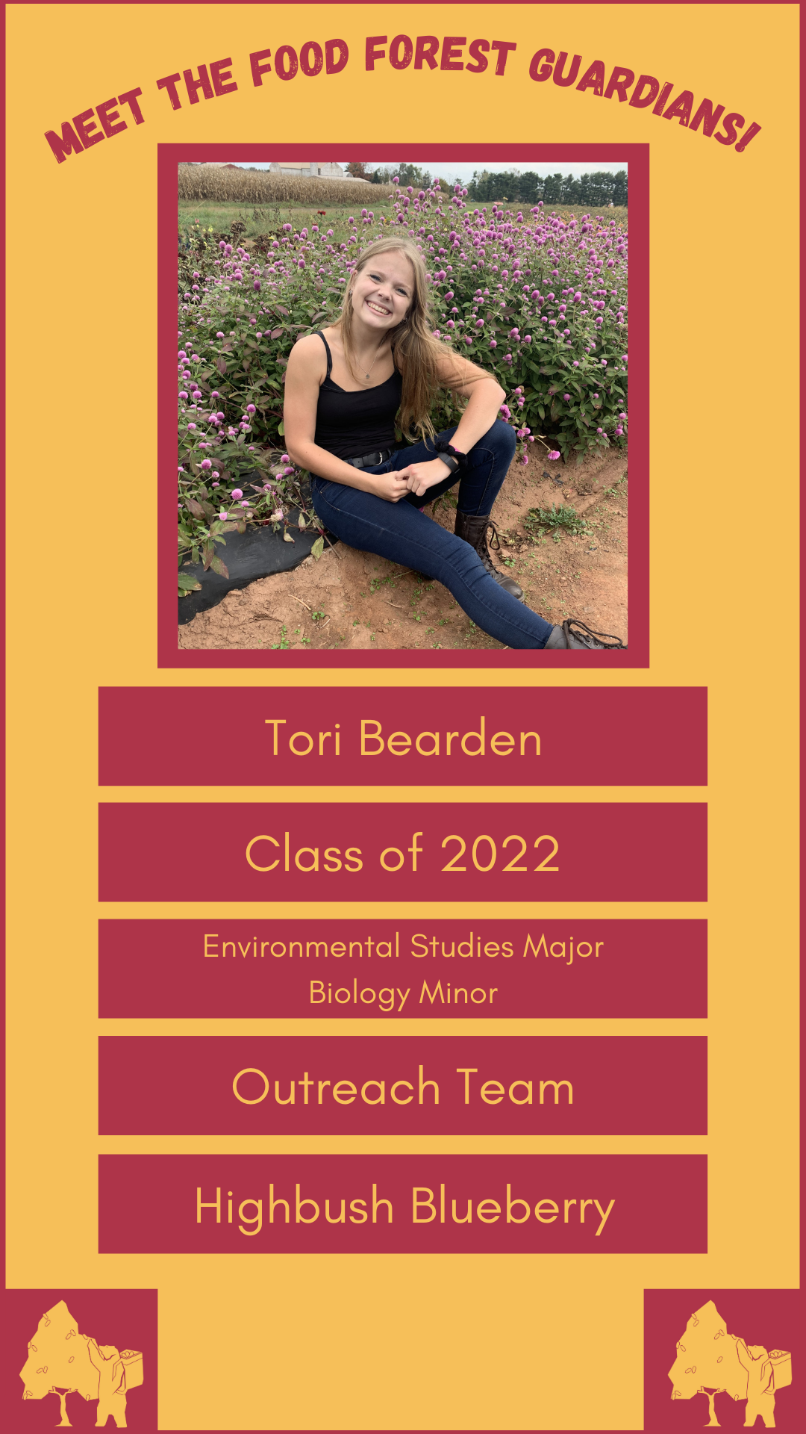
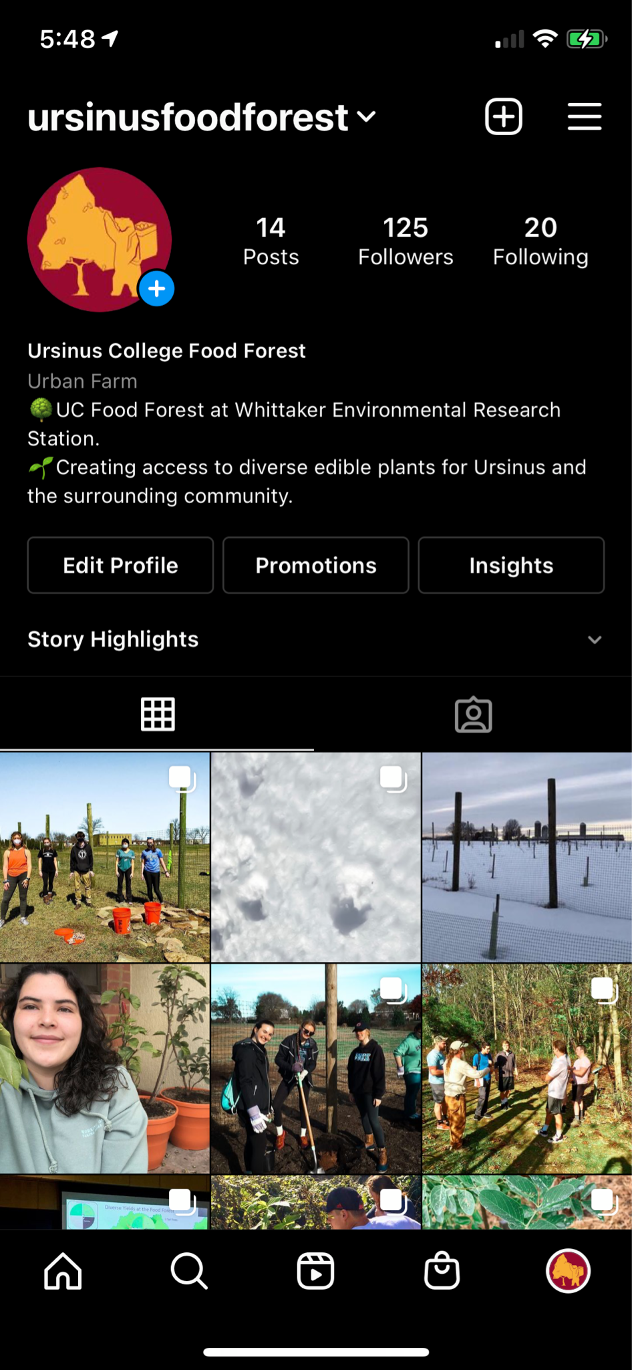
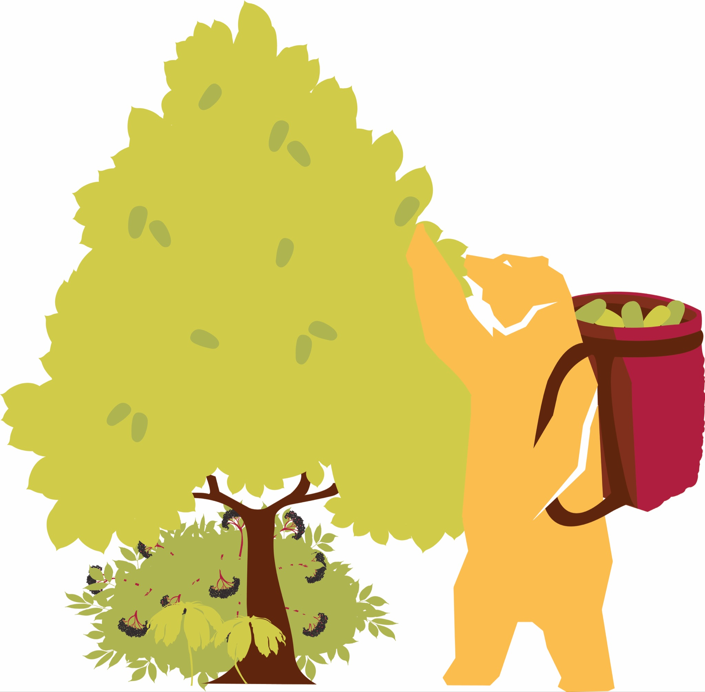
The Ursinus Food Forest Instagram
Follow us : @ursinusfoodforest
Filters and posts produced by Claire Parlee and Victoria Bearden
Created in Fall 2020
Database of captions and past pictures for preparation
Posts Include -
History of the process of creating the food forest
Updates about species growth and appearance
Planting events
Team Profiles
Sharing information from the Ursinus Environmental Department

Slide 5
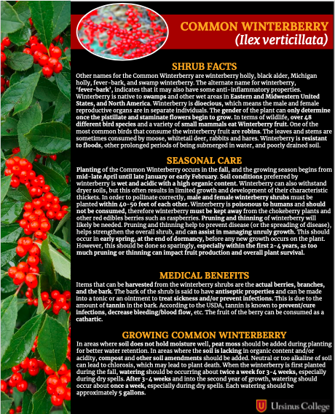
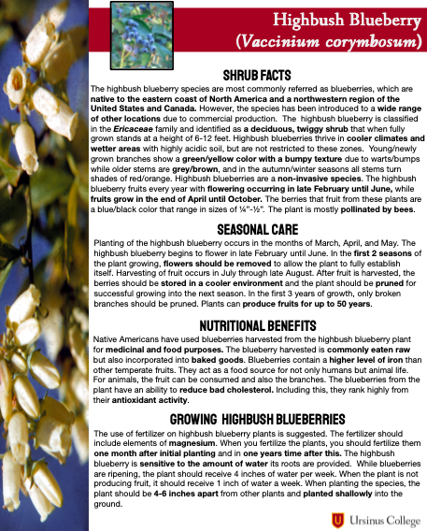
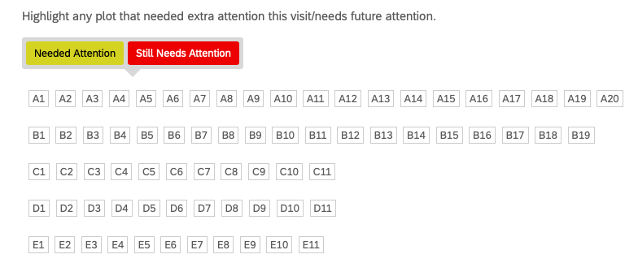
Development of Stewardship Surveys and Species Fact Sheets
Stewardship Surveys
Utilizing the Qualtrics platform
Two surveys generated for food forest stewards to utilize during visits
Provides information for plots that need attention, what was completed at the site, and what needs to be focused on in future visits
Species Fact Sheets
Provides information of each tree and shrub species found at the food forest
Includes nutritional and medicinal benefits, facts about species growth, information on seasonal care
Will eventually be implemented into a guide for food forest guardians and visitors to use

Slide 6
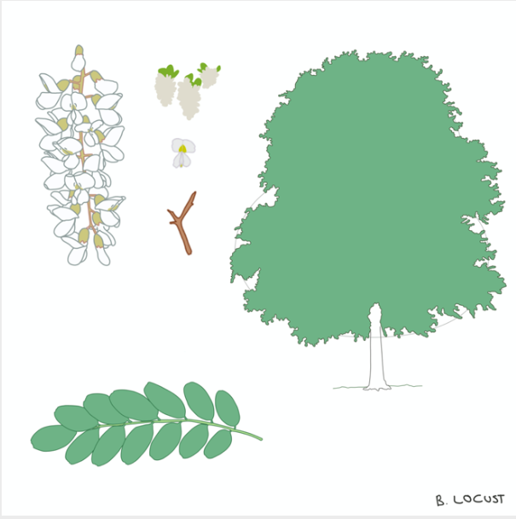
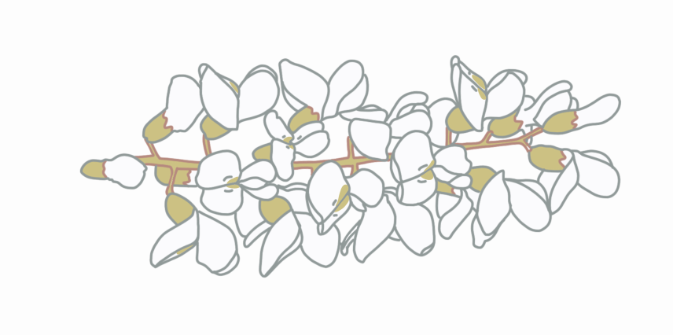
Species Renderings
Produced by Kristen Cooney
Drawings include a rendering of each adult tree or shrub species found at the site
Forageable part(s) of each species are also highlighted
This drawing specifically looks at the Black Locust species
To be used for educational purposes
Will be implemented into future maps of the food forest site

Slide 7
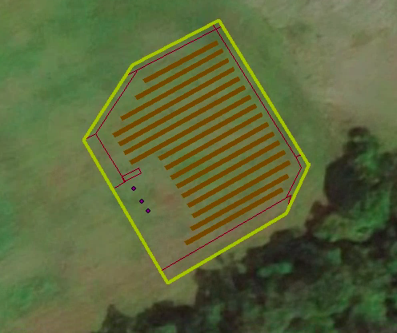
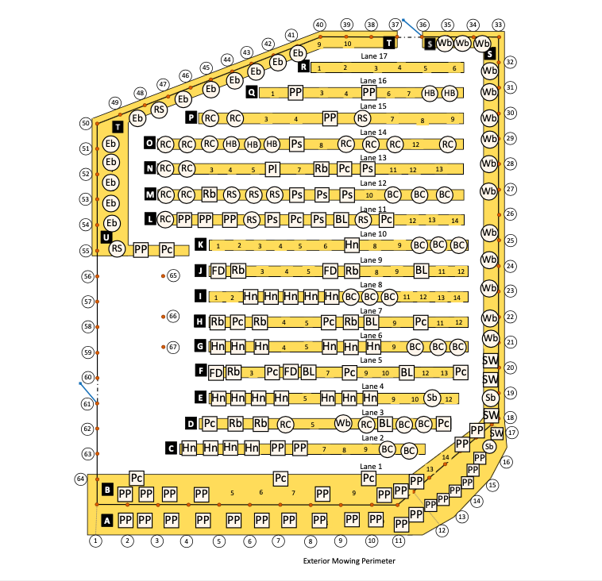
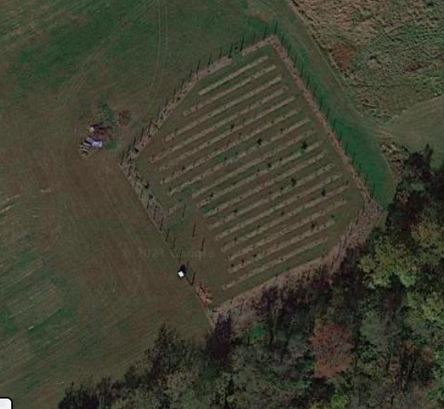
Creation of Basemaps
Produced by Victoria Bearden
Using multiple ESRI softwares to complete basemaps of the site
Legend relies on shapes, letters, and colors to identify species found at the food forest
Maps are used on site for stewards to track plants and for other projects being completed
Updates continuously happen for most accurate locations

Slide 8
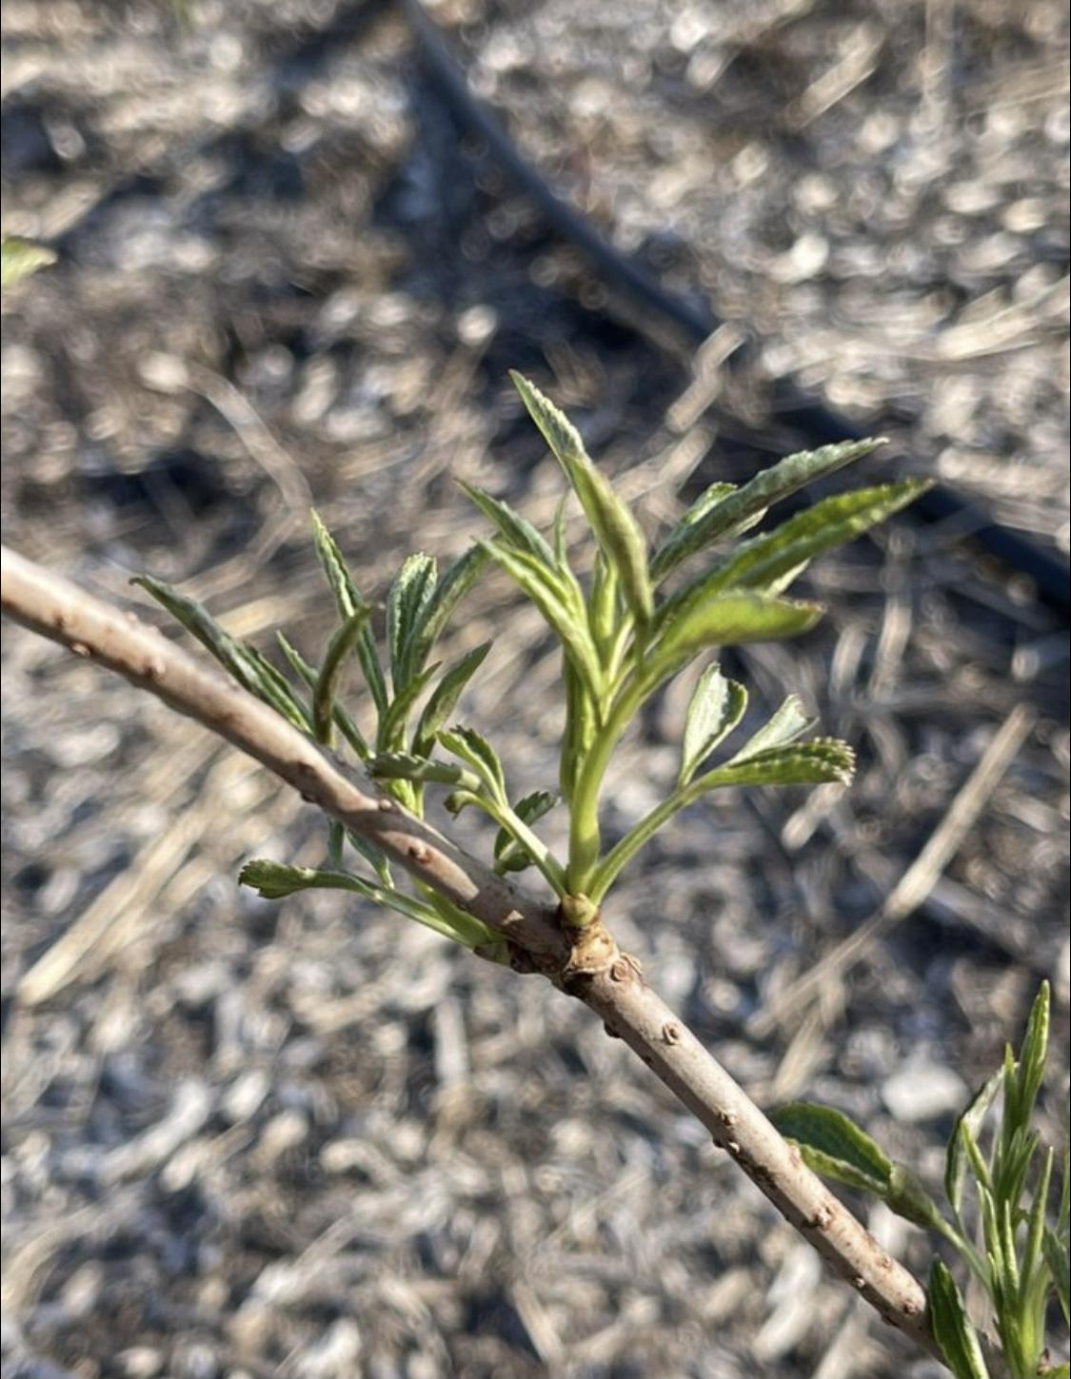
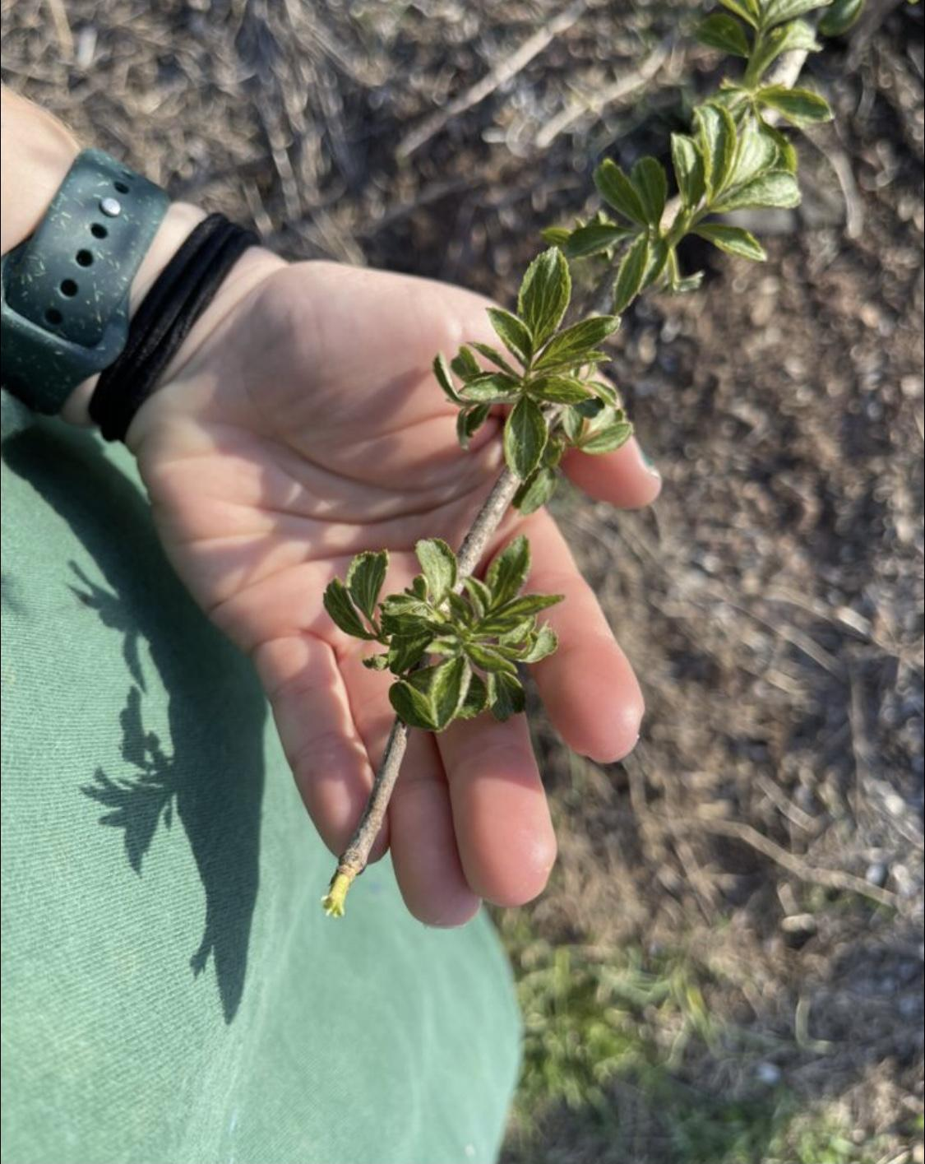
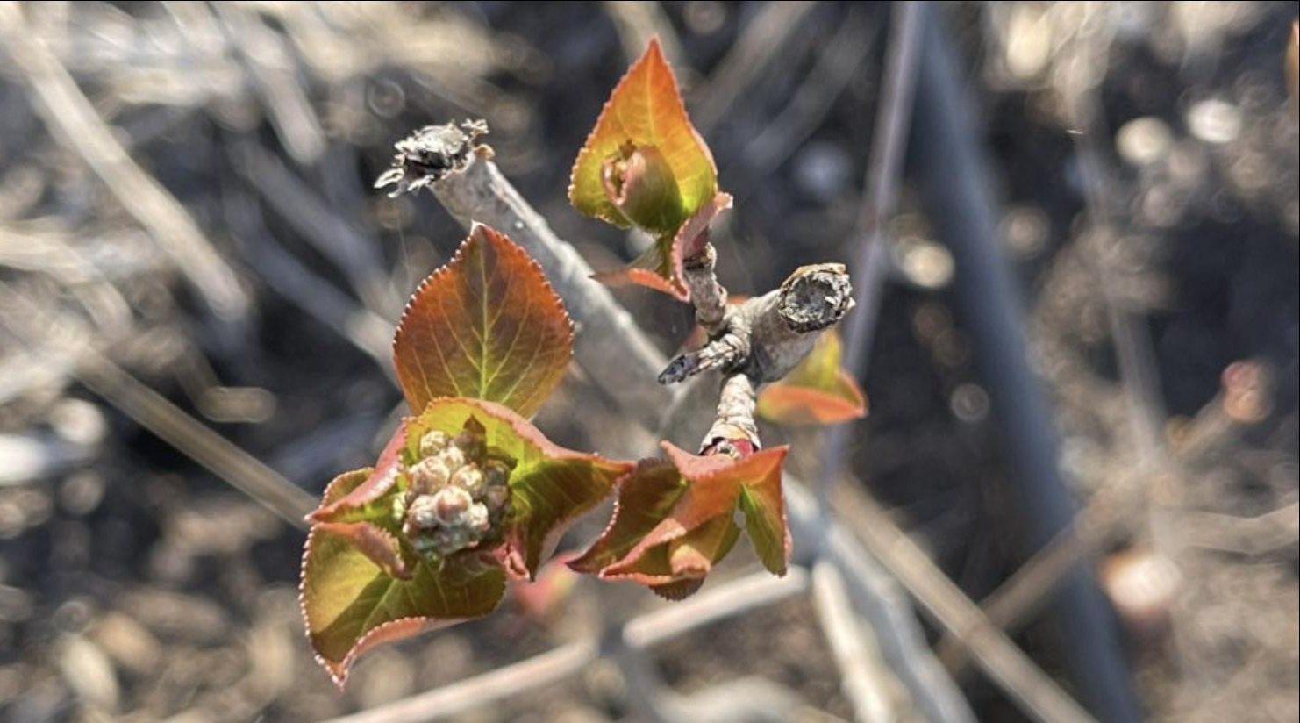
Documenting Growth Cycles
Produced by Addie Frey
Spent the semester documenting the growth of each tree/shrub species at the food forest
At this time, there are over 15 different forageable species planted at the food forest
The purpose is for future food foresters to know the growth cycles of each species
To document the beginning phases of the food forest and to see how the landscape transformed over time

Slide 9
Looking into Future Projects
Map updates of the 100+ plants of different herbaceous species during a stewardship day in April
The completion of the species renderings and growth cycles
Posts on the instagrams highlighting the team, progress of the site over the summer, and stewardship takeovers
Creation of the food forest facebook
Documenting community events and future plantings
Incorporation of the work to be completed by the capstone class in Fall 2021

