Slide 1
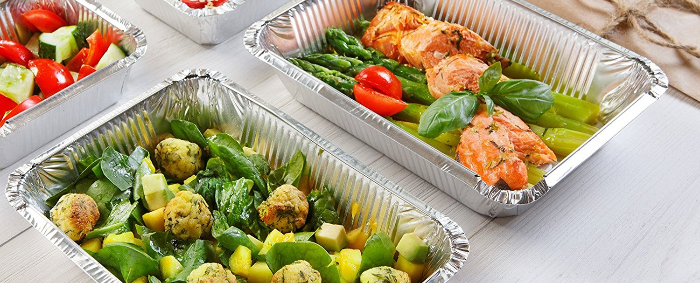
Fighting waste and feeding people: Exploring the context of campus food waste and student recovery efforts
https://i.frg.im/136gghw7/un40881.jpg
Sarah Becker - President
Max Stout - Vice President
Maddie Kuklentz - Secretary
Savona Cerra - Treasurer
Celebration of Student Achievements (CoSA)
April 23rd, 2020
Advisor: Kate Keppen
Notes:
Hi all and welcome to the first CoSA presentation by Wismer on Wheels! We are thrilled to have this time to both highlight our amazing volunteers’ accomplishments over the past year, and bring attention to campus food waste as it fits into the national food system.

Slide 2
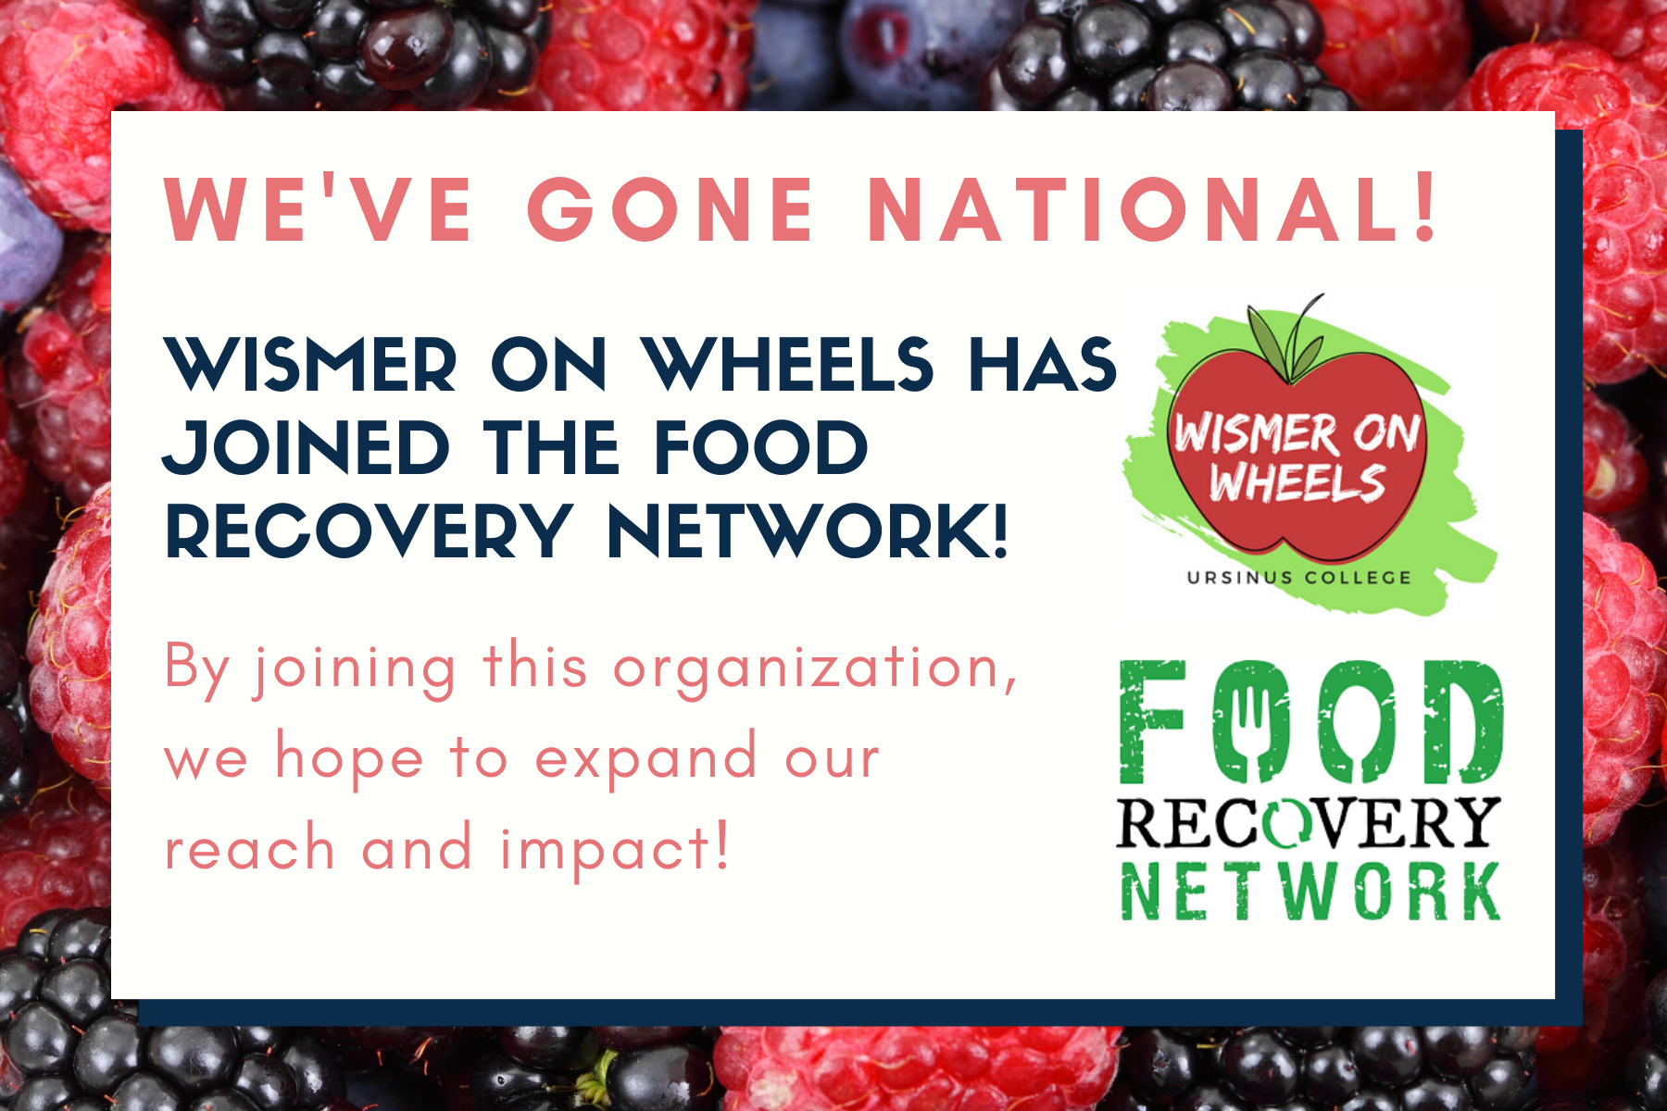
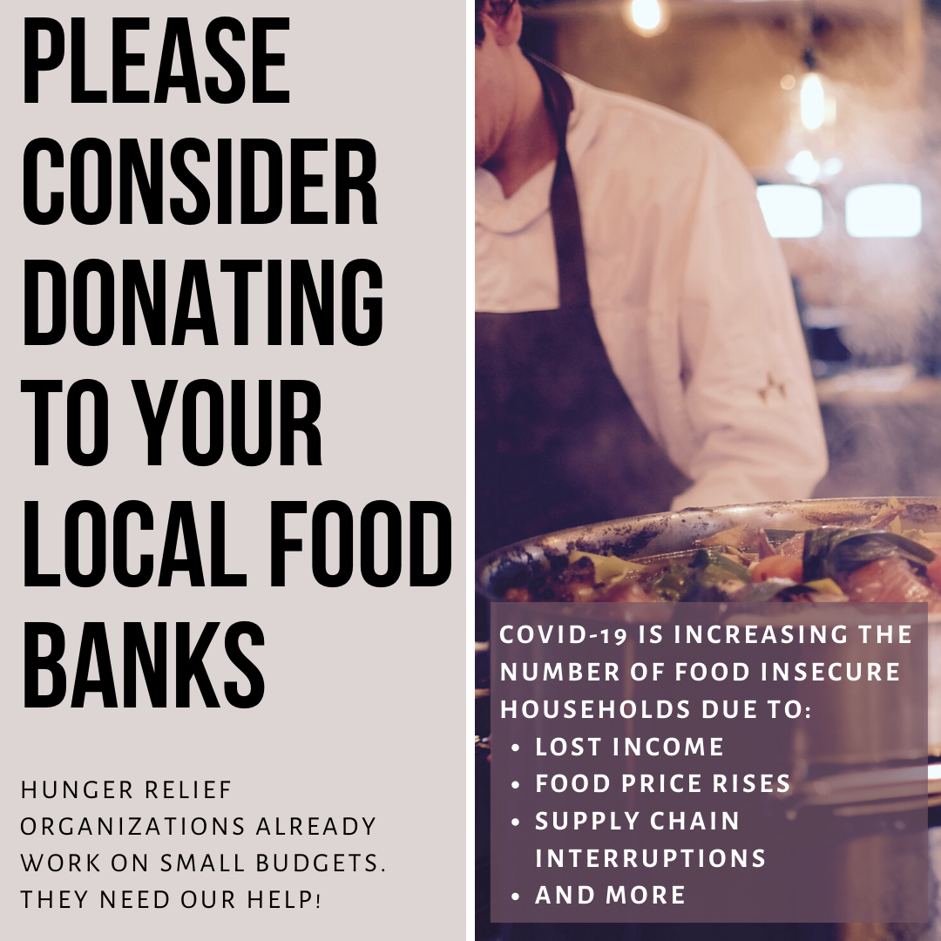
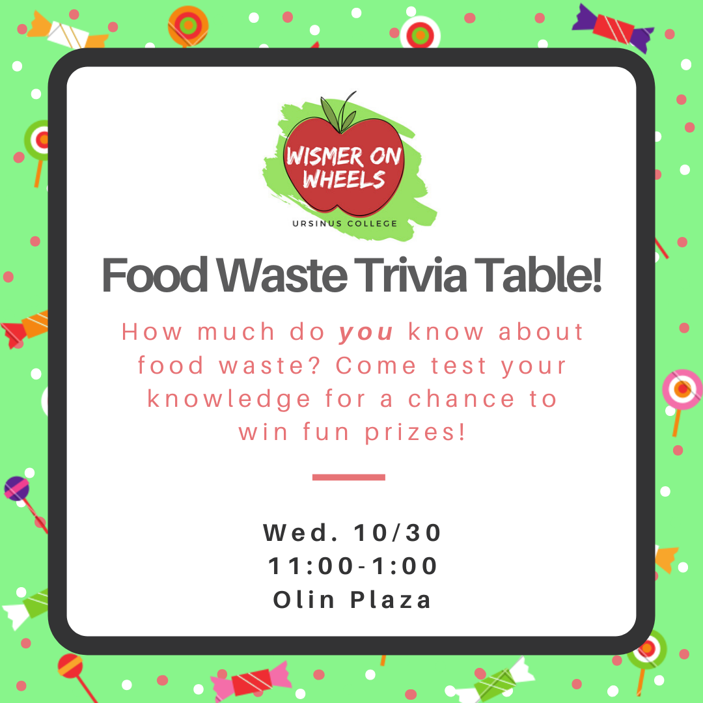
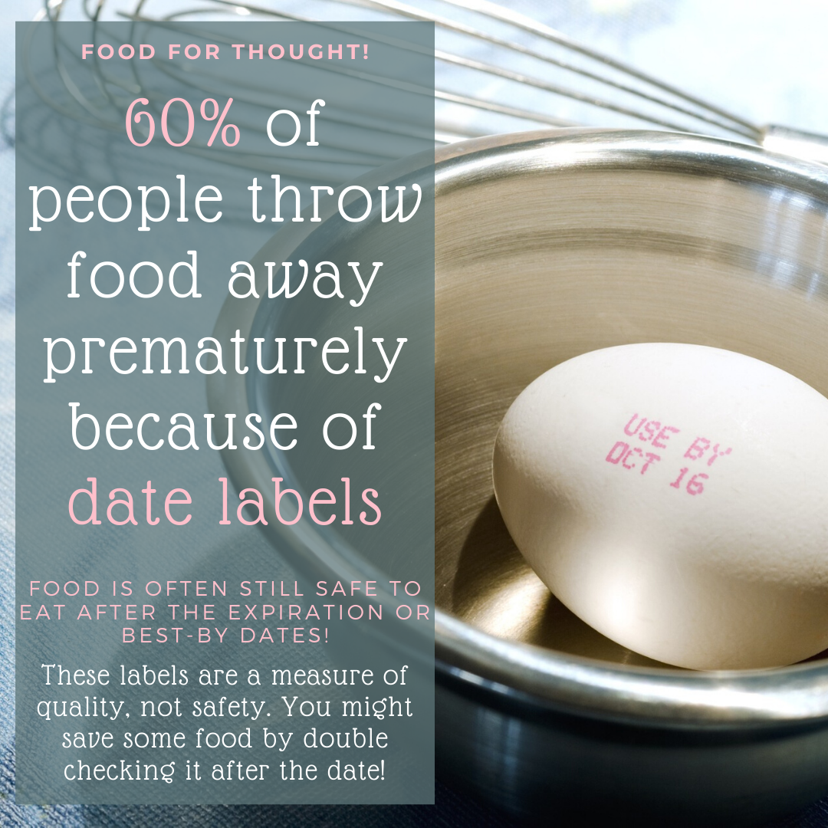
What is Wismer on Wheels?
Notes:
Some of you are bound to asking “What is Wismer on Wheels?”. You may have seen our volunteer recruitment emails and ads around campus, or even caught our Instagram takeover last month. But if you haven’t been to one of our interest meetings you might still have some questions about what we actually do on campus.

Slide 3
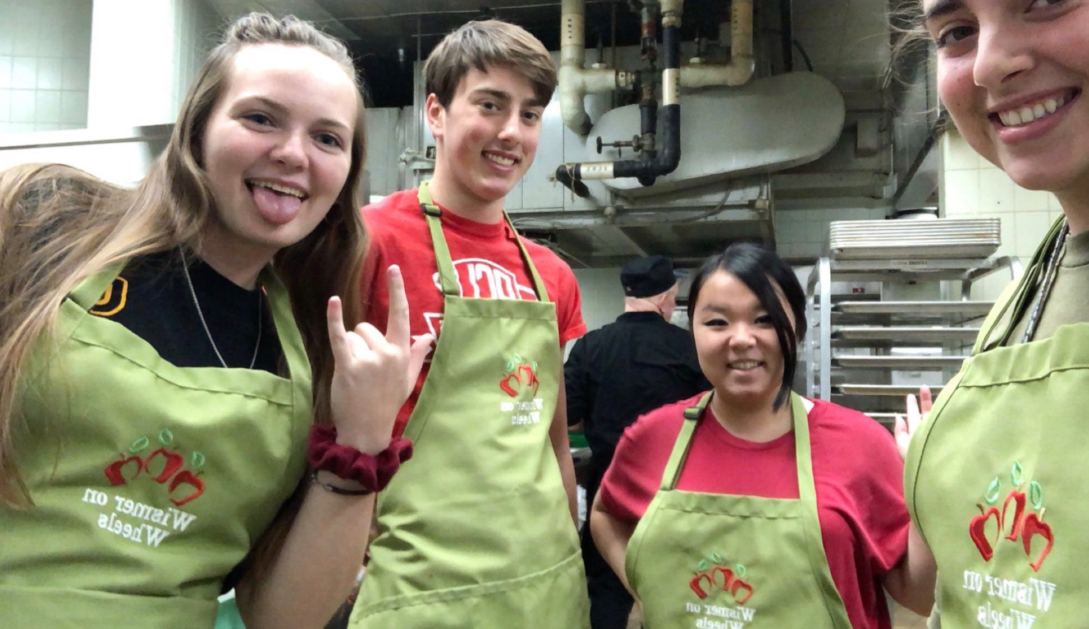
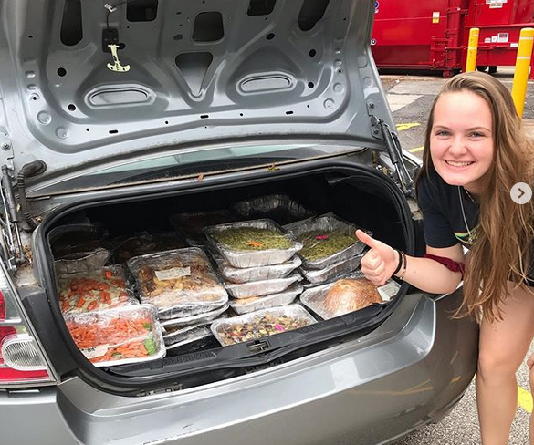
What Do We Do on Campus?
Food Recovery
12 recovery sessions/week (lunch & dinner)
35 volunteers recover otherwise wasted food
Twice weekly food deliveries to Manna on Main St. (food pantry in North Penn region)
Outreach & Education
Fall Trivia Table
Napkin dispenser food waste facts & ads
“Food For Thought” Instagram posts
Just Eat It film screening w/ Bahali Club
Notes:
Wismer on Wheels is one of the few volunteer-based and entirely student-run clubs on campus. Our club is devoted entirely to recovering leftover food from the Wismer dining hall and delivering it to our partner organization, Manna on Main Street. Recoveries happen 12 times per week - after lunch and dinner on weekdays and after dinner on weekends - in an effort to create a flexible volunteer schedule that works for students with busy schedules. Food deliveries are also student driven, with a rotation of up to six student drivers who deliver entire car trunks full of food to Manna up in Lansdale. We have had the great fortune to work with 35 amazing student volunteers this semester, and many more from past semester, who make all of this work possible. It takes a community to do this kind of work, and we couldn’t be more grateful for everything our volunteers do to foster that community.
This past year our exec board was able to expand our efforts beyond volunteering to encompass new outreach and education efforts about food waste. In the fall we held our first event: a trivia table about the campus waste that initiated some captivating conversations with students, staff, and faculty alike. We also mounted a food information campaign: both on campus and on social media. Some of you may have seen our ads and food waste facts in the napkin dispensers throughout Wismer, while other may have seen our “Food For Thought” series on Instagram. We held one of our most exciting events last month, a film screening of Just Eat It, a food waste documentary, which we cosponsored with Bahali Club. We’re hoping that these events and ads (including this presentation) will make everyone think a little harder about how they eat.

Slide 4
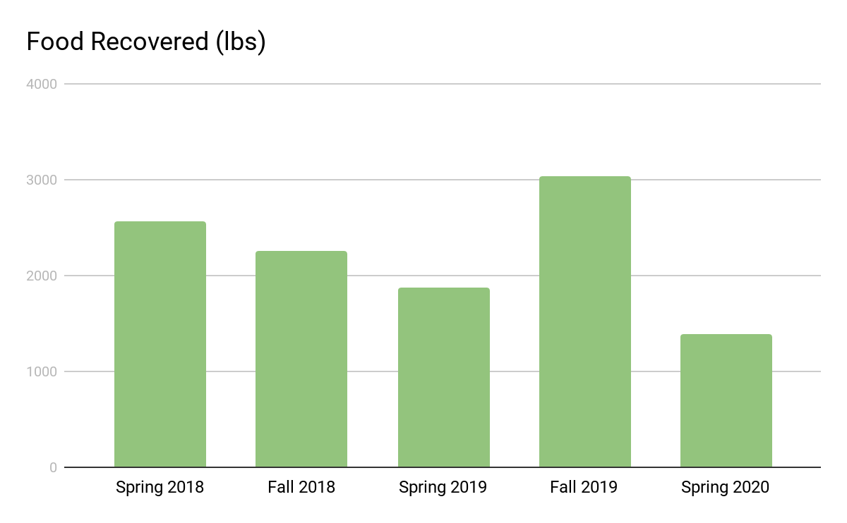
2019-2020 Food Recovery Efforts
Recovery efforts ended just before spring break b/c of COVID-19
*
2,568 lbs
2,260 lbs
1,872 lbs
3,038 lbs
1,388 lbs
Notes:
Two and half years ago we began keeping digital records of our recovery efforts, and with better record keeping comes a better understanding of what’s happening on our campus. Since the spring of 2018, we’ve recovered and redirected over 11,000 lbs of leftover food to Manna on Main Street. That’s roughly the weight of a 5-ton elephant. We had what could be described as our most successful semester this past fall, depending on whether you focus on the amount of waste generated or the amount of food we donated. We were well on our way to matching those same recovery numbers when we had to suspend on-campus volunteer work for the remainder of the semester because of COVID-19.
It’s worth noting that these numbers don’t even cover all the food waste that comes out of Wismer. Since we can only recover food that hasn't gone out to the serving line for health and safety purposes, any food left on the line or left on students’ plates is thrown away. Likewise, we can’t recover some dishes if they contain seafood, heavy dairy, or liquids. Our early data probably undercounts some of the recoverable food we can donate, since we were still securing regular volunteers and improving data reporting during those first three semesters.

Slide 5
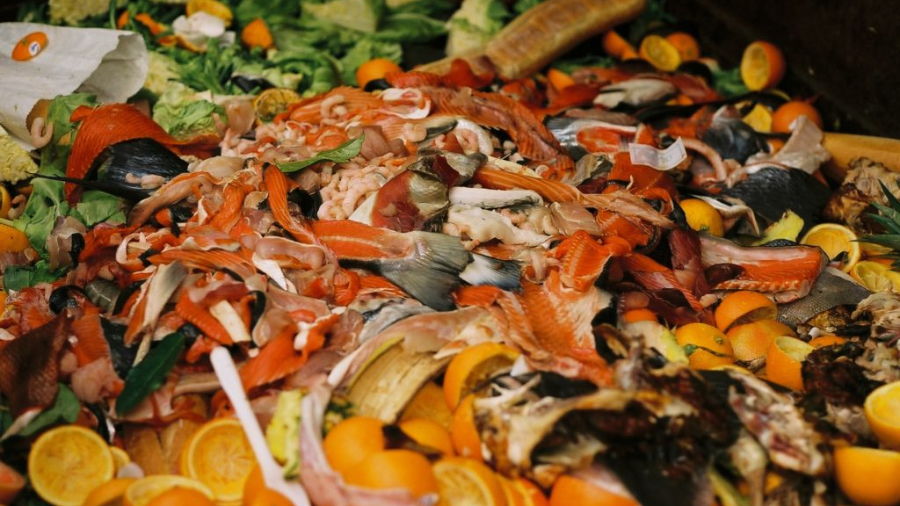
Why Are We Seeing This Much Waste?
https://cleandotwaste.co.za/restaurant-waste-disposal-important/
Notes:
But why should over 3,000 pounds of recoverable food waste per semester become the norm for our campus? Why are we seeing this much waste in a single semester? Is Ursinus unique in this regard?
If we look at other small colleges in the Food Recovery Network, schools like Allegheny, Lafayette, and Mulhenber College have semesterly food recovery totals that hover around a couple hundred pounds, but reach the occasional 1,000 pounds some semester. On the other end of the spectrum there are schools like Lycoming College where most semesters they recover around 2,000 pounds of food, with some semesters ending around 6,000 or 7,000 pounds.
At first glance, it seems as though Ursinus falls on the higher end of the food waste spectrum. Clearly we can’t make direct comparisons without knowing how frequently these schools complete recoveries and what food waste they might fail to recover. Regardless of where we fall on this spectrum, the data points to systematic issues with the college dining hall.

Slide 6
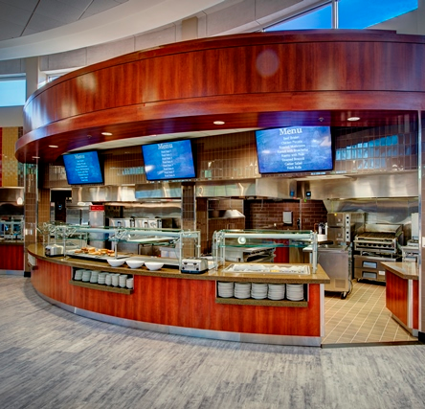
Waste on College Campuses - Dining Services
Kitchen Waste (Poon, 2015; Bloom, 2010)
Larger menu variety leads to more waste
Overbuy to avoid running out
Cafeteria Structure (Poon, 2015; Srebotnjak, 2016; Haneklau, 2018)
Overestimating demand leads to excess in serving lines
Social perceptions of abundance (Baldwin, 2014)
Self-serve lines prevent some food recovery
https://hollenbach.com/2016/05/06/ursinus-college-wismer-student-center/
Notes:
We’ll start by looking at some of the sources of food waste for dining services across colleges and universities. One of the greatest struggles that food providers face is having to strike a balance between the variety in students’ diets and the waste that larger menus produce. In order to support a large menu, dining halls then have to order an even wider range of produce in vast quantities so as not to run out. Overbuying is practically inevitable under these conditions, which always results in leftover food at the end of the meal period.
Some of this waste can be attributed to poor estimates of how much of a given dish students will eat. These estimates become dangerous when we factor in the fact that most food service industries operate with the guiding principle that there must always be an excess of food to give off the idea of abundance and desirability. This immediately brings to mind ast semester’s Fall Harvest Banquet, an event designed to celebrate abundance. After the themed lunch, our volunteers packaged 90 pounds of leftover food. Of those 90 pounds, over a third that food (37 pounds to be exact) was sweet potato casserole.
And as we already mentioned, contamination from self-serve lines also contributes to the waste we see in dining halls. The moment any food is placed on the line where students can reach it, we have to assume there is some risk for contamination. That means that even if there’s still some food in a tray at the end of the serving period, that food gets thrown out, rather than recovered and donated.

Slide 7
Waste on College Campuses - Students
“Plate Waste” (Berkenkamp, 2019)
Higher education has double the “plate waste” of corporate dining halls
Average 110 lbs “plate waste” per student per year
National studies place annual student waste around 142 lbs (Poon, 2015; Srebotnjak, 2016)
All-You-Can-Eat dining halls see 40% more waste than Pay-Per-Item options
Notes:
Food waste, however, does not rest solely on the shoulders of food providers. Students are equally responsible for a substantial amount of the waste we see on college campuses. Most often, this takes the form of plate waste: the edible food that’s left on your plate at the end of a meal and subsequently thrown away. While our club doesn’t have any Ursinus specific data about plate waste, the Sustainability Fellows have mounted efforts in the past to highlight the sheer quantity of plate waste we generate every meal.
Colleges are some of the worst offenders when it comes to plate waste. In a study that examined plate waste in institutional settings (places like offices and schools, rather than restaurants and households), they found that higher education dining halls had double the plate waste of other dining halls. Going even further, the same study found that All-You-Can-Eat dining models (think of Upper Wismer) have 40% more food waste than Pay-Per-Item models (think of Lower Wismer). Regardless of the context, students waste an average of 110 to 140 pounds of food as plate waste every year. Given our campus numbers roughly 1,400 students, a conservative estimate would place our campus plate waste at over 154,000 pounds each year. That vastly outnumbers what we’ve been able to recover over the past three years.

Slide 8
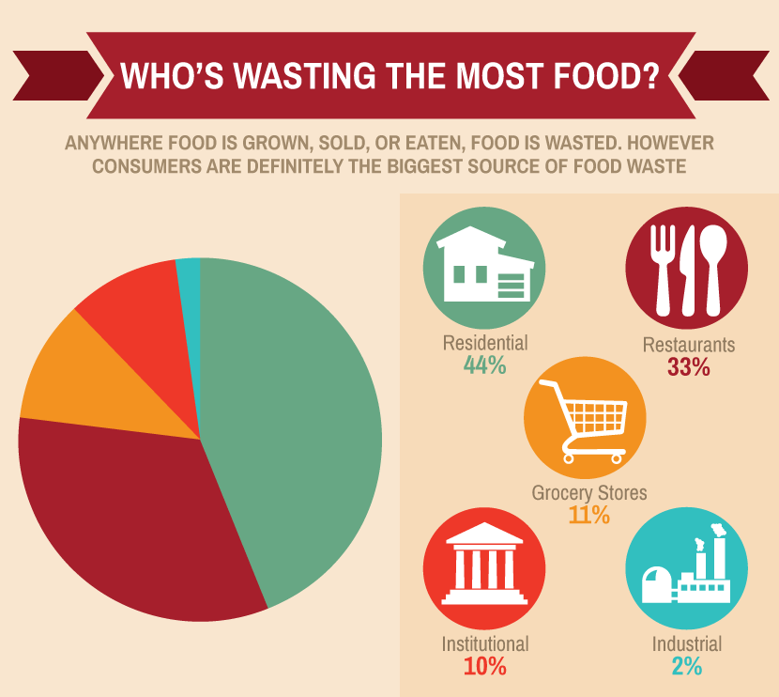
College and other institutional food waste is only one part of the wider narrative!
https://www.fix.com/blog/food-waste/
(2015)
Notes:
The most astounding thing about campus food waste is that it’s only a fraction of the food waste we see across the entire food system. As of 2015, colleges and other institutional food producers were only responsible for 10% of national food waste. Clearly there are wider dynamics at play, but what constitutes the other 90% and how does it inform our understanding of campus food waste?

Slide 9
Waste in the US Food System - In the Field
Cosmetic Waste (Bloom, 2010; Baldwin, 2014)
Edible crops rejected according to shape, size, color, hardiness, texture, & uniformity
29% of citrus & 18% of vegetable crops lost as cosmetic wasted
Unharvested Crops (Bloom, 2010)
All unharvested crops are wasted
Can be due to lack of farm labor or walk-bys (not picking/selling for profit)
http://blog.grubmarket.com/ugly-produce/
Notes:
Food waste begins all the way at the beginning of our food system, in the farm fields where all our food is grown. Here we point out just two types of waste at this level. Cosmetic waste often impacts fresh produce the heaviest. Fruits and vegetables are often subjected to a range of visual standards (things like shape, size, color, hardiness, texture, and uniformity) that have little to do with the actually edibility of the food. While some produce is rescued at this level and turned into processed foods like baby foods and sauces, not all produce is that lucky. Around 29% of citrus and 18% of vegetable crops are lost as cosmetic waste. Unharvested crops, likewise, are a more immediate form of farm-based waste. Leaving crops in the field is the result of any number of factors, ranging from a lack of farm labor to economic profitability.

Slide 10
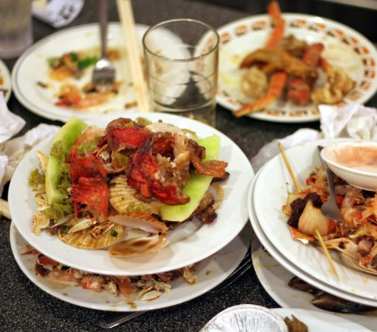
Waste in the US Food System - In Restaurants
More Plate Waste (Bloom, 2010)
On average, 17% of meals left uneaten
Unwanted side dishes, excessive portion sizes, stigma against leftovers
Large Portion Sizes (Bloom, 2010)
Born from competition & “more for less” reasoning
Customers either waste, overeat, or bring home leftovers
https://www.openaccessgovernment.org/food-operators-food-waste/64095/
Notes:
Food waste in restaurants closely mirrors the kind of food waste we see in college dining halls, just on a larger scale. The kitchen waste and plate waste in restaurant settings emerge for many of the same reasons we’ve already explored, with long menus and the desire to appear hospitable with an abundance of food as the leading culprits. In the restaurant setting, these factors lead to an average of 17% of all meals served in restaurants going uneaten. The main characteristic that distinguishes restaurants from the dining hall is the imposition of large portion sizes. Portion sizes have been rising steadily for years, born from competition between businesses and from the idea that in order to charge restaurant patrons more for a meal, they need to serve more food. Faced with that much food customers either end up wasting food, overeating, or bringing home leftovers (which happens less frequently than you might think).

Slide 11
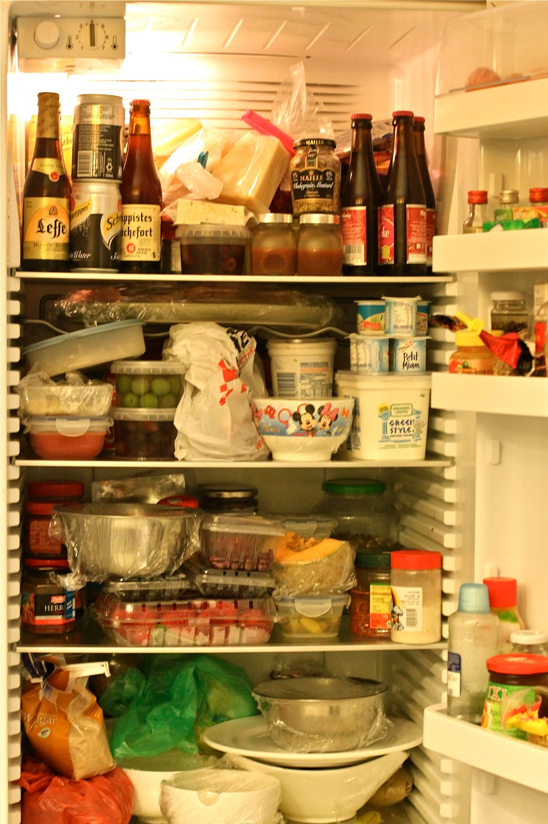
Waste in the US Food System - At Home
Household food waste estimate range from 15% to 33% of what we buy (Bloom, 2010; Penn State, 2020)
Modern Lifestyle (Bloom, 2010; Baldwin, 2014)
Refrigerators creates false sense of security
Overbuying & forgetting produce
Unfamiliar foods lead to more waste
Diminished kitchen smarts about food safety means more’s thrown out
https://www.appliancesonline.com.au/academy/cleaning-2/how-to-organise-a-fridge-eight-tips-for-a-more-efficient-kitchen/
Notes:
The final source of food waste that we’ll consider here is food waste from home. Residential food waste made up 44% of all food waste in the US, as of 2015. On average, most households will waste approximately 15% to 1/3 of all the food they buy. Once again, those are staggering numbers. A lot of this waste can be attributed to our modern lifestyles. The use of large refrigerators in most homes, for one, tends to create a false sense of security for consumers, who will let food go bad in there under the pretense that there’s no rush to use items up or who may even forget what food they have stored in its depths. Forgetting about produce, just to buy more of the same item from the store, is just as wasteful in that regard. More adventurous eaters, like those constantly discovering new recipes online, tend to buy unfamiliar ingredients they won’t necessarily incorporate into new dishes. Those items join the rest of the food loitering in our fridges before we throw them away. Not all of the food we throw out goes bad before we do so, though. The decline of what food waste experts call “kitchen smarts” means that most of today’s consumers don’t necessarily know how long food stays good. A reliance on best buy dates over your own sense of smell means a lot of people throw away food while it’s still good to eat.

Slide 12
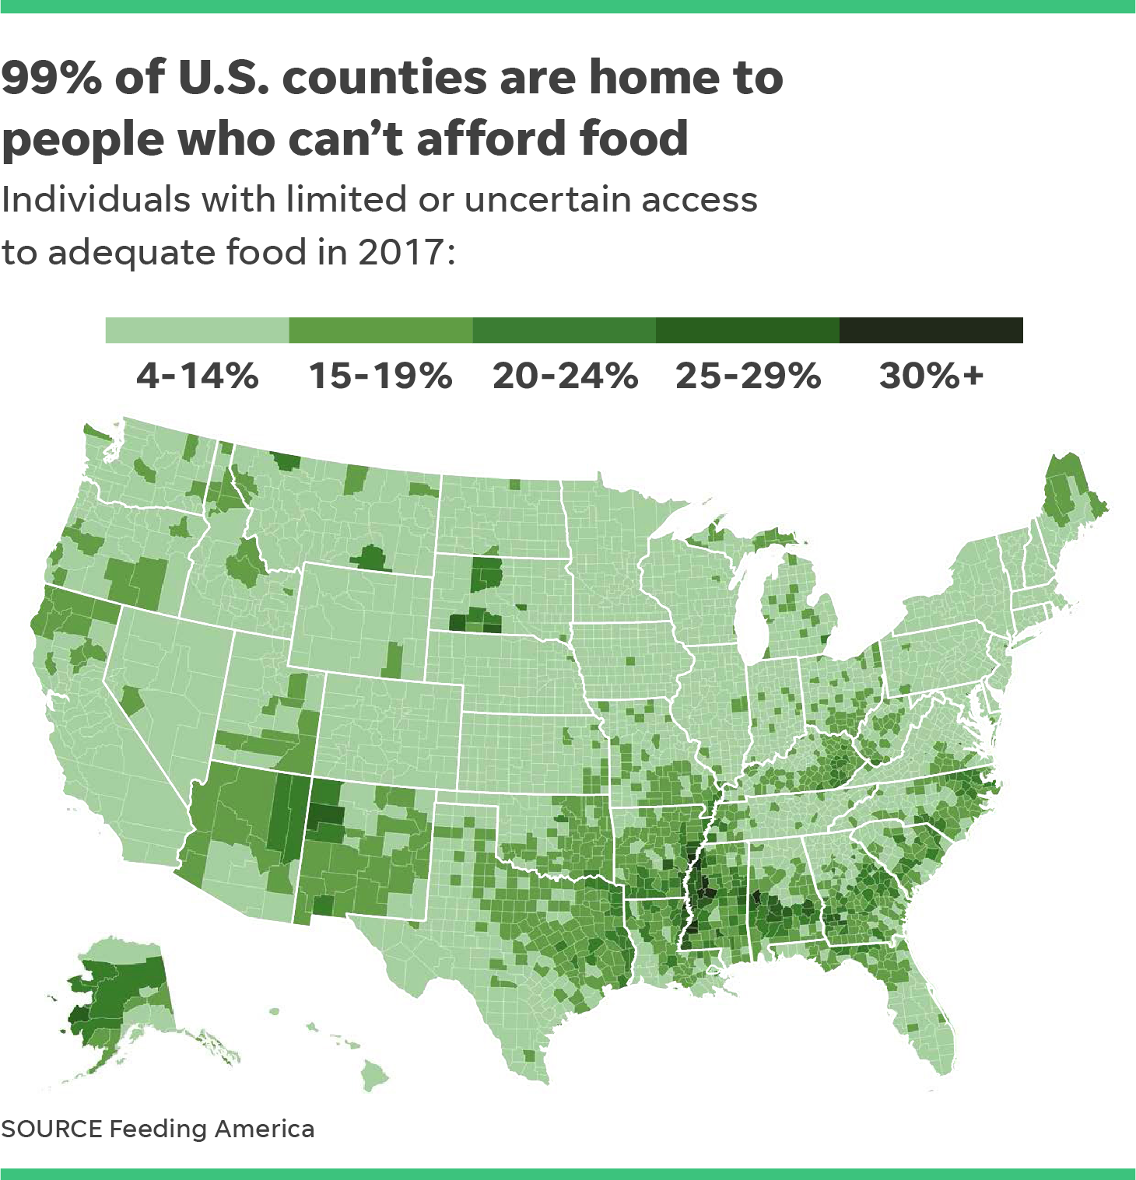
Food Insecurity
With so much food waste, why do so many go hungry?
1 in 9 people in the U.S. struggle with hunger (Feeding America, 2020a)
Availability, access, & stability (Feeding America, 2020b)
Closely, but not exclusively, related to poverty (Hunger + Health, 2020; Feeding America, 2020a)
Other drivers of hunger (Laborde et al., 2016)
Income, gender inequality, sanitary conditions, & market access costs
https://map.feedingamerica.org/
Notes:
We would be remiss to talk about food waste without talking about the other end of food availability spectrum. While we’ve spent the past seven slides exploring food waste in dept, we’ve barely touched on the food insecurity that also plagues the United States. One in nine people in the US struggle with hunger. That means that over 11% of the people in this country alone struggle to find a food source that consistently provides them with healthy and reliable food that they can access. There isn’t a single county that doesn’t have some degree of food insecurity. Most often, hunger is disproportionately affecting already disadvantaged communities. Families struggling with poverty and low incomes, female-led households struggling with the impacts of gender inequality, black and brown communities struggling with racism, and many others face these additional barriers to food access.

Slide 13
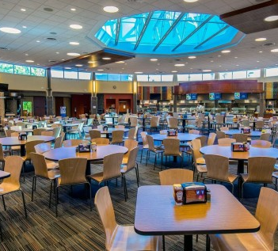
What Does This Mean for Ursinus?
Our national food system strives to create foods that conform to the ideas of perfection and abundance as markers of success.
https://www.ursinus.edu/student-life/dining/
Notes:
But what does food waste in the rest of our national food system have to do with Ursinus? Why is it even important? If there’s one thing we should take away from today’s presentation, it’s that our food system is fixated on the symbol of abundant, perfect foods as a marker of success. That symbol permeates what we expect of food everywhere, and thus the kind of perfection and abundance we expect from Wismer.
But why should we still buy into the concept of perfect produce and perfect foods when the natural world - agriculture included - is defined by imperfectly beautiful diversity?

Slide 14
What Can We Do?
Be mindful of your eating!
Pick foods you know you’ll eat
Start with smaller serving sizes, then go back for more
Join Wismer on Wheels and help us redirect excess food to where it’s needed most!
Talk with Sodexo about the changes you want to see in Wismer!
We’re happy to help you get started
Change how we see food - it’s a right, not a commodity!
Notes:
The good news is we don’t need to subscribe to those ideas. There’s plenty each of us can do to address food waste on campus and in our daily lives. Just being mindful of what you eat can be an impactful step. Picking foods you know you’ll eat, or sampling unfamiliar foods before taking large servings can cut down of food waste dramatically. Likewise, starting with a small serving before returning for seconds can reduce the food left on your plate at the end of a meal.
If you’re looking for more organized actions, Wismer on Wheels is always looking to welcome more volunteers into our community as we fight waste and feed people! We’ve seen an increase in volunteers the past couple semesters, and would love to see those numbers continue to rise. You can also take a more direct approach that addresses the root of campus food waste by organizing with others to start a conversation with Sodexo.
More than anything we need a paradigm shift in how we think about food. Food sustains our very lives, and as such it should be a right that everyone has equal access to the healthy foods of their choice. Until we recognize that truth we won’t be able to change our food system to reflect it.

Slide 15
References
Baldwin, G. (Director). (2014). Just eat it: A food waste story. [Film]. Peg Leg Films.
Berkenkamp, J. (2019, August 19). The quest for cleaner plates. [NRDC Expert Blog]. Retrieved from https://www.nrdc.org/experts/joanne-berkenkamp/quest-cleaner-plates.
Bloom, J. (2010). American wasteland: How America throws away nearly half of its food (and what we can do about it). Da Capo Press.
Campus Dining Inc. (2017, April 25). Food waste and sustainability on campus. Retrieved from http://campusdining.net/food-waste-sustainability-campus.
Feeding America. (2020a). “Food Insecurity”. Accessed April 18, 2020 from https://www.feedingamerica.org/hunger-in-america/food-insecurity.
Feeding America. (2020b). “Hunger in America”. Accessed April 18, 2020 from https://www.feedingamerica.org/hunger-in-america.
Haneklau, J. (2018, December 3). Food waste on college campuses is extreme. The Breeze. Retrieved from https://www.breezejmu.org/opinion/opinion-food-waste-on-college-campuses-is-extreme/article_0156c344-f4b7-11e8-8b3b-ab6f6b18f1c3.html.
Hunger + Health. (2020). “Understand Food Insecurity”. Accessed April 21, 2020 from https://hungerandhealth.feedingamerica.org/understand-food-insecurity/.
Laborde, D., Majeed, F., Tokgoz, S., & Torero, M. (2016). Long-term drivers of food and nutrition security. International Food Policy Research Institute. Retrieved from http://ebrary.ifpri.org/utils/getfile/collection/p15738coll2/id/130336/filename/130547.pdf.
Penn State. (2020, January 23). US households waste nearly a third of the food they acquire. ScienceDaily. Retrieved April 18, 2020 from www.sciencedaily.com/releases/2020/01/200123095853.htm.
Poon, L. (2015, February 27). When food is too good to waste, college kids pick up the scraps. National Public Radio. Retrieved from https://www.npr.org/sections/thesalt/2015/02/27/389284061/when-food-is-too-good-to-waste-college-kids-pick-up-the-scraps.
Srebotnjak, T. (2016, August 23). Food waste at U.S. colleges and what to do about it: How can colleges reduce food waste? HuffPost. Retrieved from https://www.huffpost.com/entry/food-waste-at-us-colleges-and-what-to-do-about-it_b_57bcbc22e4b007f1819a1070.
Notes:
Thank you all for your time! We are thrilled to bring attention to this pressing campus issue, and hope you come away with a better understanding of Ursinus’ place in the food system. Please feel free to reach out to us if you want to learn more about food waste, and be sure to keep an eye on your inboxes for updates from us as we restart our recovery efforts in the fall.

