Slide 1


Assessing Woody Species in the Philadelphia Urban Forest: Foraging Potential Versus Actual Practices
Sarah Becker (UC)
April 24th, 2019
Celebration of Student Achievement (CoSA)
Patrick Hurley, Ph.D. (UC)
Marla Emery, Ph.D. (USFS)
Jenna Detweiler (UC)
Victor Fernandez (UC)
Notes:
Good afternoon everyone. My name is Sarah Becker and I am a student at Ursinus College. I have been working as a part of the People and Urban Forests research group at Ursinus for almost two years, studying urban foraging practices in Philadelphia.

Slide 2
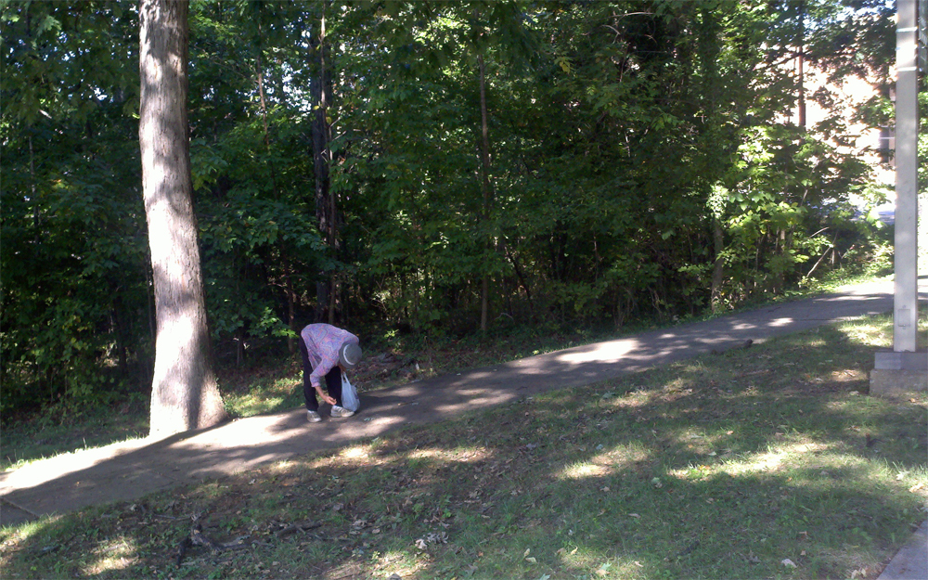
What is urban foraging?
What is Urban Foraging?
Plant harvests for food, medicine, and other material/cultural uses (Jahnige et al. 2001, McLain et al. 2013, Poe et al. 2013, Hurley et al. 2015, Shackleton et al. 2015)
Community of practice among diverse residents (McLain et al. 2013, Poe et al. 2014, Hurley et al. 2015, Shackleton et al. 2018)
Ubiquitous urban practice (Shackleton et al. 2018)
White oak acorns in Baltimore, MD
Notes:
When I say urban foraging, I’m referring to the harvest of plants or of plant parts by humans for food, medicinal, or other cultural uses. It’s recognized as a set of practices with which a diverse community of urban residents engage. Recent research with studies emerging that document cases of foraging across multiple continent suggest that foraging is a ubiquitous urban practice.

Slide 3
Forageability of Urban forests
Demand perspective
  Maintenance of cultural/family identities (Poe et al. 2014; Hurley et al. 2015; Landor-Yamagata et al. 2018)
  Food/medicine sovereignty (Poe et al., 2013)
  Nutritious foods/part of diet (Synk et al. 2017; Stark et al. 2019)
  Connections to nature (Poe et al., 2014)
Supply perspective
  Design-oriented recommendations (Clark & Nicholas 2013;
  Bukowski 2017) or policy considerations (Kowalski & Conway 2018)
  Desirable species widespread (Larondelle & Strohbach 2016;
  Russo et al. 2017; Stark et al. 2019), including among street trees (Hurley & Emery 2017;
  Production of desired fruits lower in urban trees (Bunge et al. 2019)
Notes:
Most research into urban foraging has focused on the demand perspective of this practice. Overall, this means researching which foraging practices exist within foraging community, the motives behind their continued practice, and how foraging impacts community members. It’s widely known and accepted within the research community that city residents obtain a large number of material benefits from urban forests. These benefits include the maintenance of cultural identities and food sovereignty amongst others.
Recently, there has been an emerging focus on the supply side of urban foraging that has led to a focus on the species composition of urban forests themselves. Three lines of inquiry emerge here. The first provides design-oriented interventions with the intent of achieving various food goals. The second focuses on studying and recognizing that desirable species are widespread within urban forests, and the third studies the productivity of such desirable species.
A degree of caution is necessary when studying the supply perspective, especially if it’s undertaken to inform urban forest managers and the decisions they make. Managers need to be able to consider the effects of species selection in urban forests that impact both foraging and non-foraging practices. For example, when pursing types of intervention with the intent of making urban forests more forageable one shouldn’t assume that certain species are more desirable than others, only to discover that intervention outcomes do not benefit foragers.

Slide 4
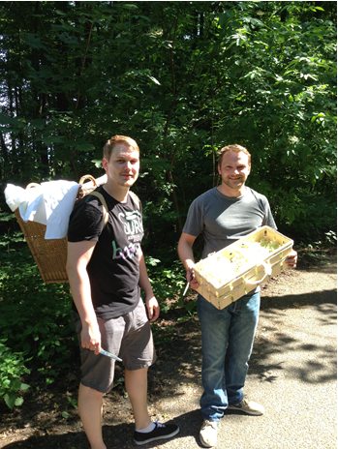
Research Focus
  How do existing urban forests align with documented foraging practices?
  Problem:
  Data on woody species in some cities,
  but limited data → foraging practices in most cities
Elderberry flowers in Berlin, Germany
Notes:
Our research attempts to combine these concepts of both supply and demand in foraging practices to determine “How existing urban forests align with documented foraging practices”.
While we have access to data regarding the species composition of urban forests, the main constraint we encounter comes from the limited data of documented foraging practices.
“existing urban forests” signifies both the spp. composition reported in the inventory and the actual spp. composition

Slide 5
Determining alignment… quickly
Harvested Species
Forageability – Taxa with known uses
Species present in city
Identified uses for species (literature reviews and online databases)
Actually Foraged – Taxa documented as harvested
Species documented through interviews/surveys/observation
Respondents identify which materials harvested, how used, and where harvested
Rapid Assessment - Desirability
Online databases and frequency in foraging guides – proxy for likely harvested
Plant species found in Selected City
Plants with
associated
uses
Notes:
To overcome these limitations, we turn to a process of determining the alignment of foraging practices with existing urban forests. This is largely a process of narrowing. We are able to estimate the alignment through the triangulation of multiple data sources such as literature reviews, online databases, surveys, and interviews.
We start with the complete inventory of all plant species in a selected city, then narrow our list to include those species with known foraging uses. [Advance Slide] These are what we consider potentially foraged species. Once the forageability of an urban forest is determined, the next step consists of gathering documented accounts of foragers harvesting specific species, along with which materials they harvested, how they are used, and the location from which they were harvested. [Advance Slide] This lets us further narrow our dataset to encompass only the harvested species of the urban forest. [Advance Slide]
As part of this process, we looked for easily accessible resources that can serve as a proxy for identifying which species within a given urban forest inventory can be classified as harvested species.

Slide 6
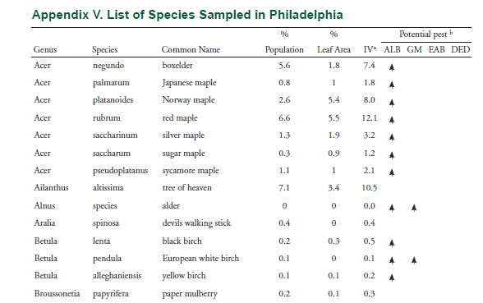
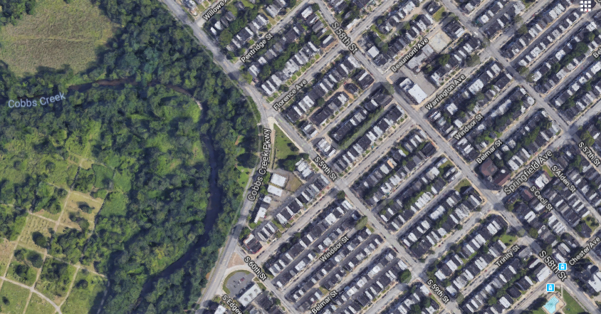
Philadelphia Urban Forest Inventory
2.1 million trees
15.7% tree cover
25.1 trees / acre
Maple
[Air Photo]
Birch
Mulberry
Nowak et al., 2007
Notes:
We can examine how this process works in more detail by looking at the foraging data we have collected in Philadelphia. The city possesses 2.1 million trees that provide 15.7% tree cover at a density of 25.1 trees per acre. The distribution of the canopy cover is uneven, as you can see from the air photo in the bottom right, with types of tree cover ranging from parks and yards to street trees.
We used the appendix from the Nowak et al. Philadelphia urban forest inventory as a starting point for this assessment. When considering the forageability of Philadelphia’s urban forest, we find that of the 79 woody taxa reported in the inventory (divided into 69 specific species and 10 genera [jen-er-ah]), 75 have documentation of potential uses (94.9%).
These potential uses are relatively evenly distributed between the three material use categories of food, medicinal, and other uses. The plant materials with the greatest number of potential uses were bark, followed by leaves, stems, and shoots, and fruits, nuts, and seeds (91 counts; 23.32%).

Slide 7
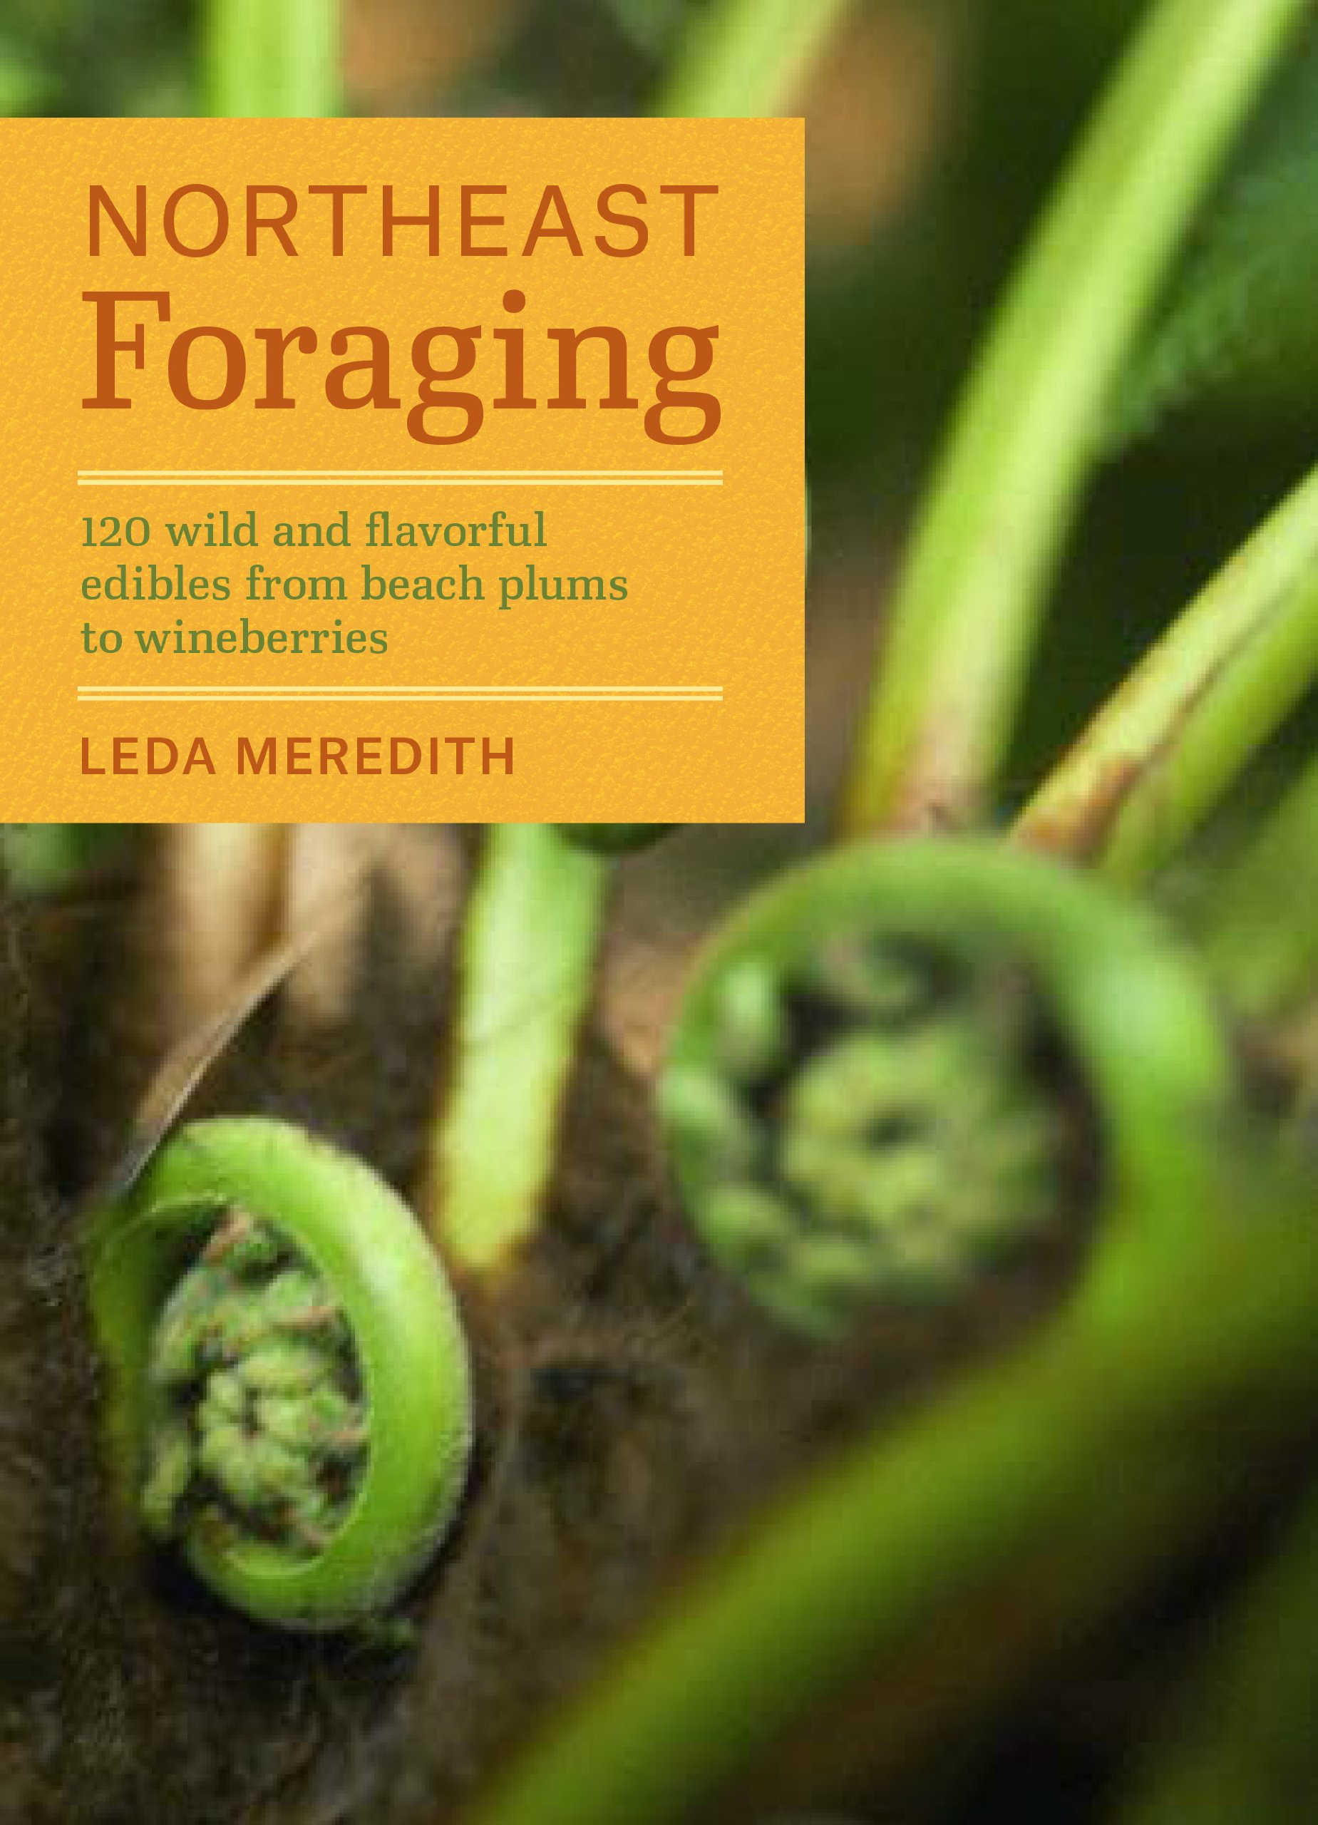
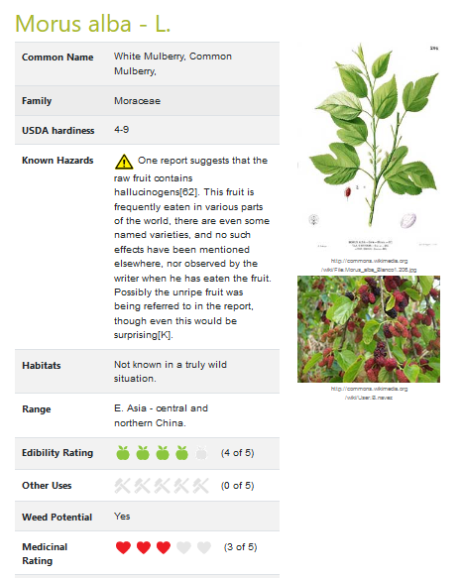
Desirability Values
(Meredith, 2014)
Plants for a Future, 2017
Notes:
As a part of the process of understanding the alignment, we further narrowed down our list of forageable species to only encompass those we were confident to be of some value to foragers. To do so, we used the online database PFAF and the Northeast Foraging guide by Meredith.
PFAF is a useful database that ascribes desirability ratings to productive species on a scale from “1” to “5”. Species with a score of “1” have “very minor uses” for that use category while those with a score of “5” have “great value”. For example, a species with an edible desirability rating of “1” is considered a famine food. For our purposes, urban forest species with a desirability rating of 3 or greater were included in the inventory subset of species with associated foraging uses. The Meredith field guide was used as a check to determine if a desirability rating of 3 is a good cutoff for these species.
Note to self: Use of PFAF & Meredith intended to overcome doubt from lack of voucher (survey/interviews).

Slide 8
Philadelphia Urban Forest Inventory
Nowak et al., 2007
Notes:
For example, if the overarching taxa of maple has some known foraging use, then the specific maple species found in the urban forest inventory would also be ascribed those potential foraging uses according to their presence in Meredith (2014) and/or a desirability rating of 3 or higher from PFAF. Through our cross-referencing with Meredith we found that three of the seven maple species correspond to the overarching taxa’s uses. By contrast, despite not being mentioned in Meredith (2014) the three species of birch were included because they all possess desirability rating of 3 or higher.
Of the 66 inventory species for which desirability ratings were available, 36 species have an overall desirability rating of three or greater, while 30 species have a rating of less than three. Of those species with ratings of three or higher, three species had an overall desirability rating of five, seven species had a rating of four, and 26 had a rating of three.

Slide 9
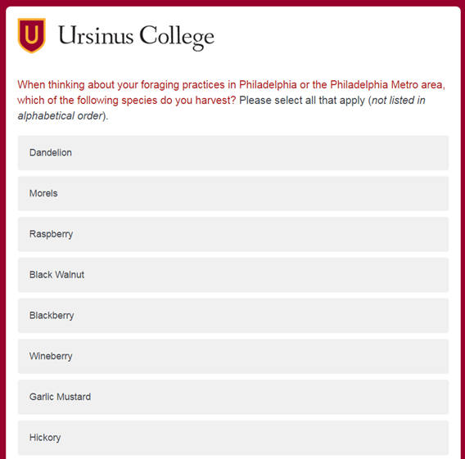
Identifying Forager Practices
85 responses
  64 species identified (128 in previous interviews)
37 completed surveys
  Mostly well-educated white (81%) women (78% )
  3% Amer. Indian/AK Native, 3% Black/Afr. Amer., 3% Hispanic
Notes:
Documented counts of foraging practices were extracted from a 2013-2014 online survey circulated to foraging groups in the Philadelphia metropolitan area. Respondents indicated which taxa they harvested by either selecting them from a pre-provided list of 30 taxa, or by self-reporting any taxa not included on that list. Respondents were also asked to provide information on what plant parts or materials they harvested from each taxon, along with the way in which those materials were used. Survey results were supplemented with data from 28 in-depth interviews conducted between 2008 and 2014. To avoid conflating data, we did not include additional counts of taxa mentioned in interviews if that taxa was already reported by a survey respondent.
While we should point out that the demographics of our survey respondents here are predominantly well-educated white women, we know based on ongoing studies elsewhere it is unlikely that the species captured by respondents would change dramatically with a more diverse sample. Were the sample more diverse, it is more likely we would see a shift in the frequency of harvest/importance of species to different demographics, rather than a shift in which species foragers harvest. Uses and meanings to these groups likely would also differ.

Slide 10
Philadelphia Urban Forest Inventory
Nowak et al., 2007
Notes:
Of the inventory’s 75 forageable species, survey responses correspond to 22 of these species and interview responses correspond to an additional 16 species. Combined, survey and interview responses report a total of 38 foraged taxa from the inventory (50.7% of the forageable taxa). This means that nearly half of all species (49.3%) with potential foraging uses are not being harvested by foragers. These 38 taxa correspond to 55.9% of the city’s total tree population. By contrast, 44.1% of the urban forest consists of woody taxa that do not match foraging practices documented by interviews and surveys.

Slide 11
Desirability Ratings (N=66)
Notes:
When we visualize the results of this alignment according to the desirability ratings of each species, graphed along the x-axis, we can see that, overwhelmingly, foraging practices correspond to desirability ratings of 3 or higher. Two thirds of taxa with high desirability ratings were indicated as being harvested by foragers. Notably, there was only one species with a desirability rating of 5 that foragers did not indicating harvesting (Hamamelis virginiana - witch hazel).

Slide 12
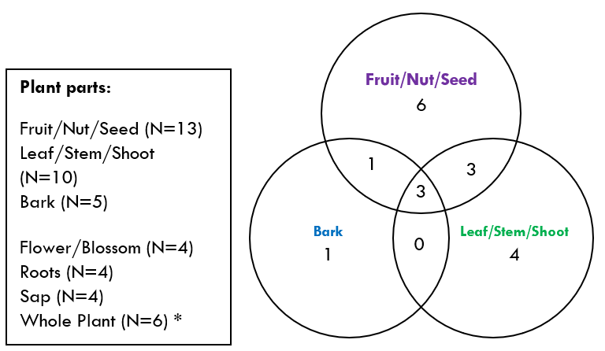
Distribution and overlap of foraged plant parts by species correspondence
Modeled from Landor-Yamagata et al., 2018
Notes:
Our results also show that overall, the plant material grouping that was harvested from the greatest number of taxa were the propagules (fruit/nut/seed), followed by leaf/stem/shoot, and bark (inner and outer). A fair amount of overlap exists, indicating instances where multiple plant materials are harvested from the same species.

Slide 13
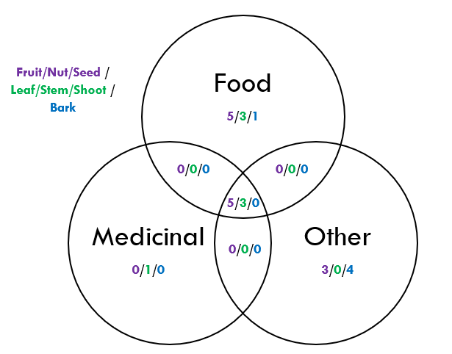
Distribution and overlap of Material uses by species correspondence
Modeled from Landor-Yamagata et al., 2018
Notes:
Shifting to look at how foragers use the plant materials they harvest, the clearest pattern is that a notable number of species are harvested for food uses. The overlap in this figure represents instances when the harvested materials from some species also being used for both medicinal and other uses, not just for food. A relatively small number of harvested plant parts have exclusively non-food related uses.
If we examine the distribution of material uses in conjunction with the three most commonly harvested plant parts, we can see that fruits, nuts, and seeds are overwhelmingly associated with food-based uses. Bark, by contrast, is more heavily associated with other uses, such as basketry.

Slide 14
Frequency of mention by foragers
Taxa ----- (% population ⸙ cumulative % population)
12 spp. each at 1 (1%)
(4,3)
(3,3)
(3,1)
Brambles (berries) & other frequently harvested species → not inventoried
Taxa not captured by sampling protocols
(3,2)
(NR, NR)
Notes:
The frequency with which taxa are reported as harvested by respondents provides another perspective through which to analyze this alignment. The five most frequently foraged spp. (mulberry, black walnut, cherry, crabapple, and black locust) represent 55% of the taxa foragers mentioned harvesting, but make up 24.9% of the urban forest tree population.
The desirability ratings for these five species (displayed in red) are all 3 or higher. However, it is interesting to note that beyond the cutoff, higher desirability ratings do not necessarily equate to greater frequencies of mention. For instance, despite having a desirability rating of 5, sassafras was the 7th most frequently foraged species. Also of interest is the fact that fruits/nuts/seeds are the plant materials most frequently associated with the harvested of these five species.
[Advance Slide]
When managers are determining the impacts of intervention efforts on foraging practices we need to consider more than just which inventory species are targeted most frequently. We also need to remember that inventory sampling methods impact the alignment. Some of the harvested species that foragers mention frequently are not included in the inventory from the start, such as brambles. Despite being woody species, brambles do not meet the inventory criteria to be counted as shrubs.
Even with woody tree species that are captured by sampling methods, there are certain species that are more abundant in the urban forest than the forest assessment recognizes. The ginkgo tree is one such species; a frequently harvested item with a desirability rating of 5 that we know is found in Philadelphia but is not captured in the inventory. The survey data that reports the actual harvest of ginkgo in Philadelphia shows us that ginkgo is frequently harvested from street trees. It is possible that sampling methods underrepresent street trees in the inventory, a dynamic that was also observed in a separate analysis of New York’s inventory data.

Slide 15
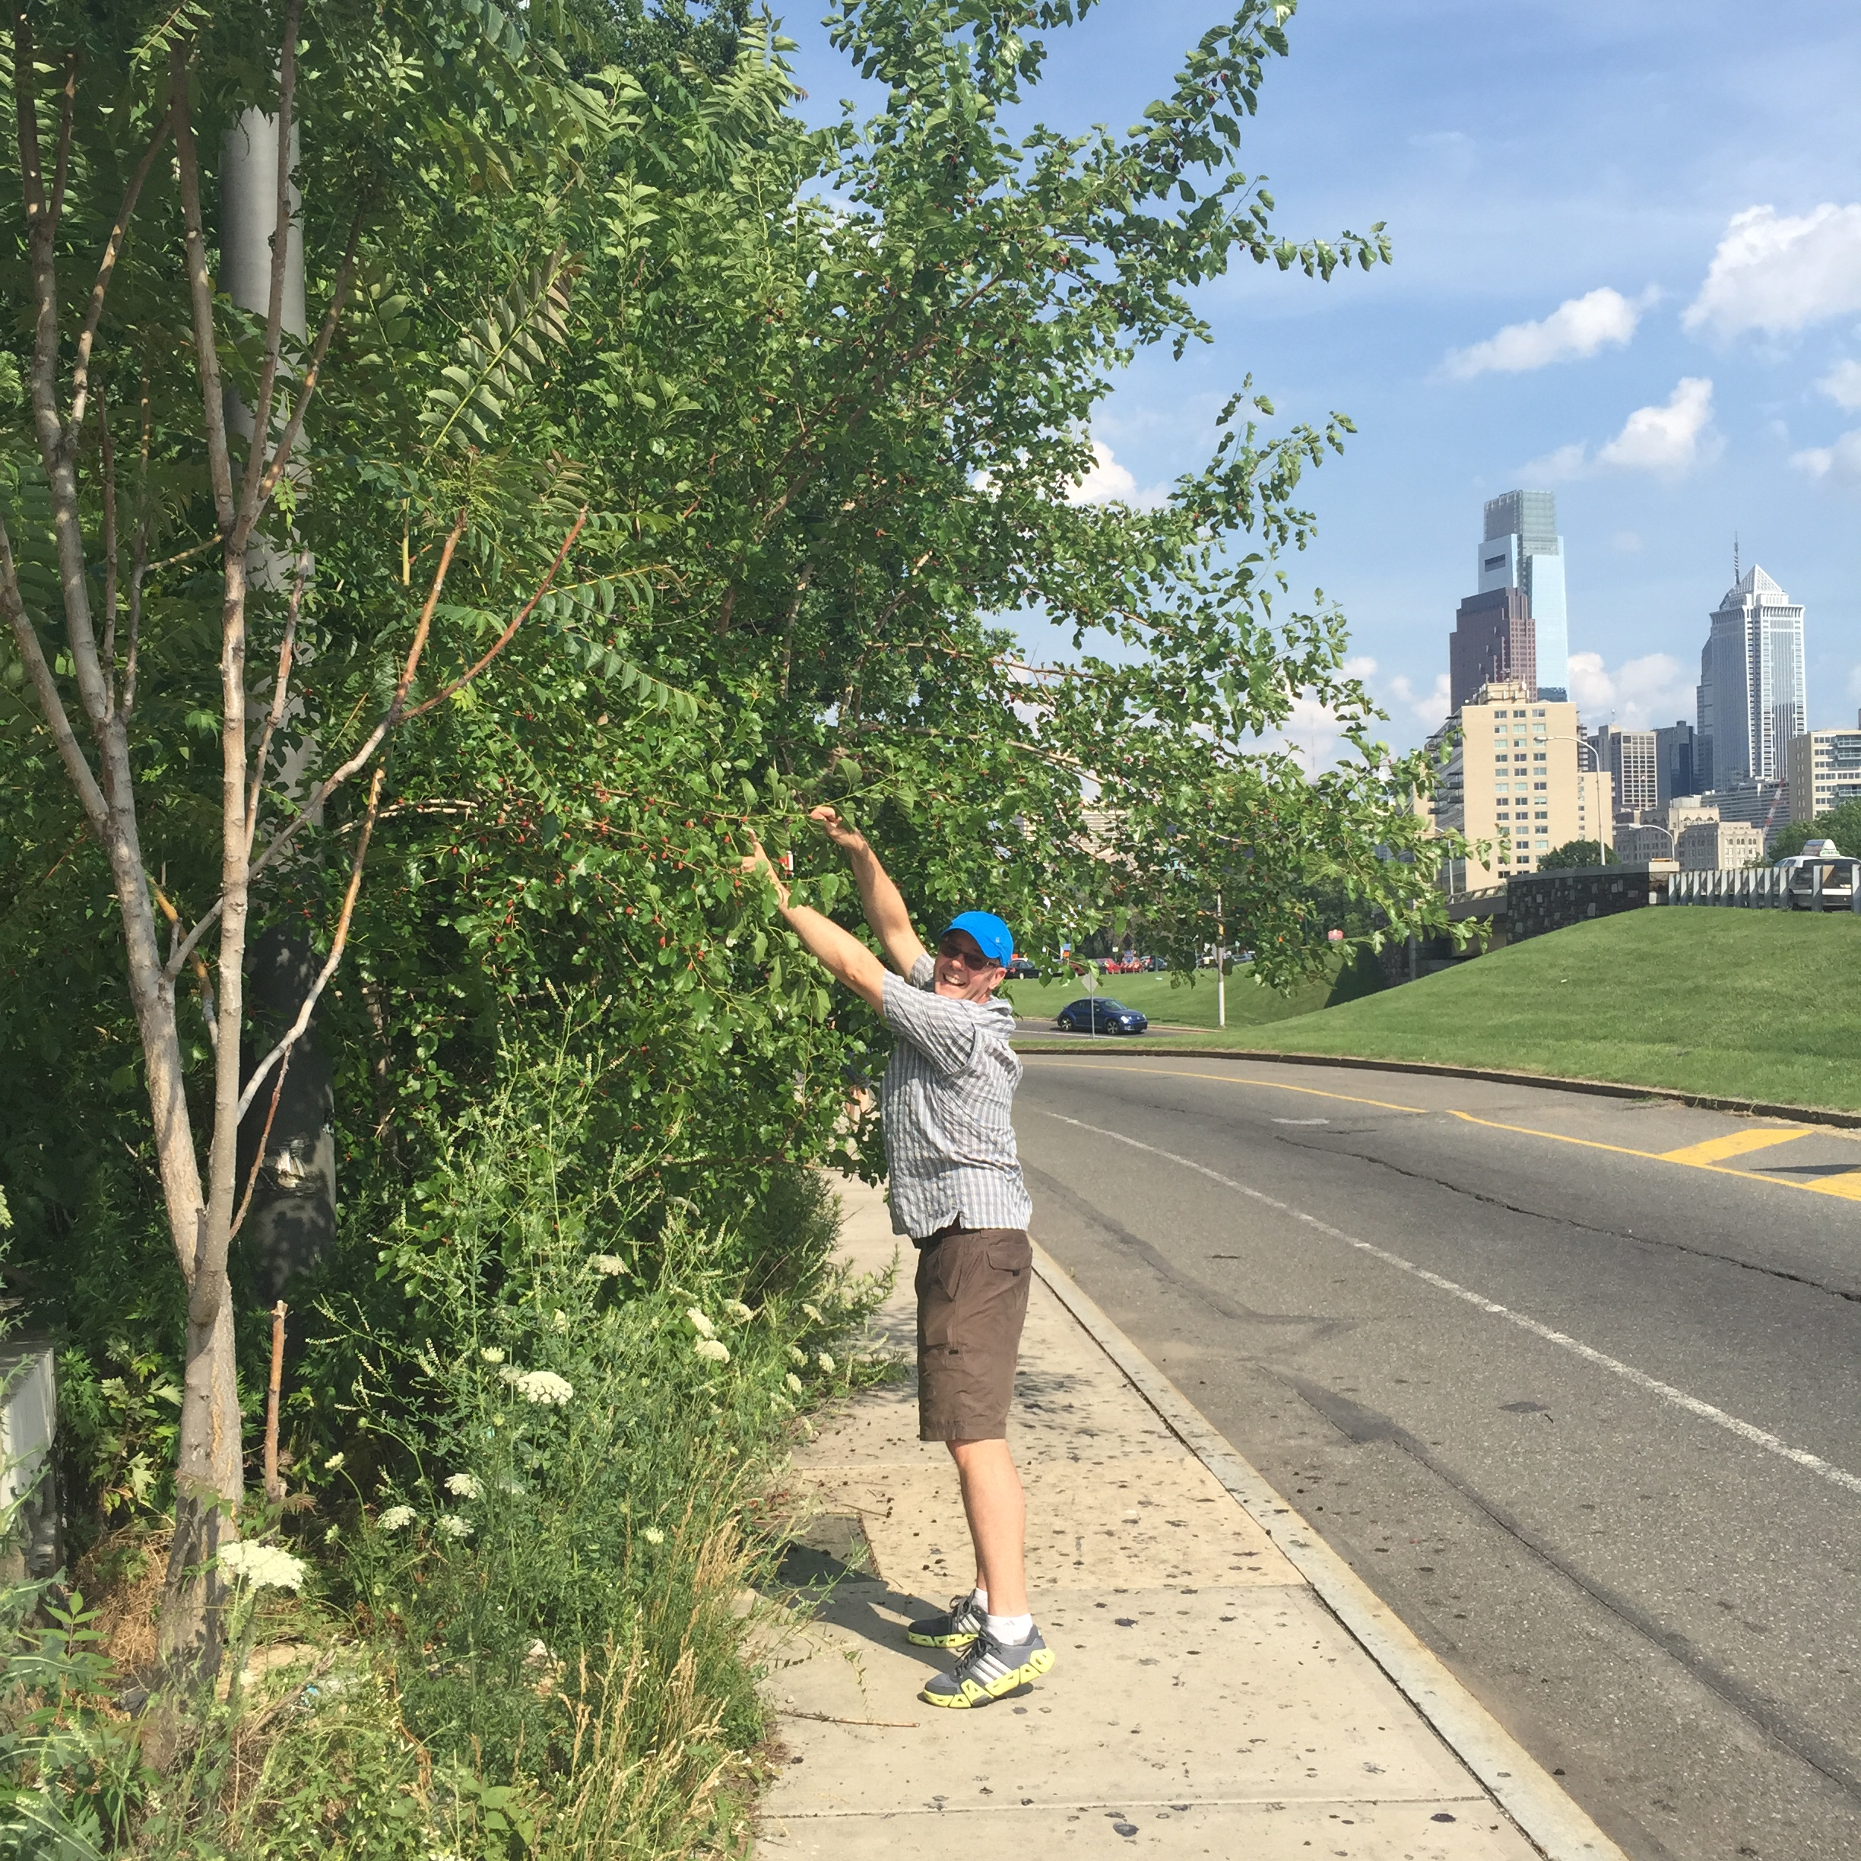
conclusions
People in Philadelphia are using woody species from urban forests (Not just food)
Alignment with the urban forest inventory
  Wide scope harvested but narrow range heavily targeted
  Further inventory of brambles & other species needed
  Fruit/nut/seed interventions would appear to enhance documented practices
Mapping desirability ratings (enhanced with field guides) → rapid assessment
Notes:
From these results we are able to form a better understanding of the foraging practices in Philadelphia’s urban forest. Not only are people in Philadelphia using the woody species of the urban forest, but they are harvesting a variety of plant parts for all three material uses. Even though it is not a new concept, it should be emphasized that people are using the materials they harvest from urban forests for purposes other than food and medicine. These craft uses are worth recognizing.
The supply of valuable woody tree species in the Philadelphia urban forests is extensive, with over 50% of the tree population capable of supporting some documented foraging activity. As mentioned before, documented foraging practices encompass a wide variety of species from which plant parts are harvested for all three material uses. However, the foraging practices with which the majority of foragers engage are narrow in focus. Of that large supply, only a portion of the urban forest (~25%) is being heavily targeted by foragers. The harvest of fruits nuts and seeds for food purposes is the predominant practice in which the largest number of foragers we sampled engage.
Unfortunately, since they are not captured by the urban forest inventory, the alignment of brambles and other woody tree species that foragers indicated harvesting cannot be fully assessed by this method. Further inventorying of these taxa could provide researchers and managers alike with a better understanding of how foragers are interacting with urban forests. Given our understanding that foragers target the fruits, nuts, and seeds of woody trees and brambles, it would seem likely foragers would welcome it if managers were to engage in supply-side interventions focused on targeted propagules.
Even with a more comprehensive inventory from which to draw, this consuming method of determining alignment is not a rapid assessment that managers could use to determine how foragers may be using specific cities’ urban forests. However, the close association of high desirability ratings from PFAF with the taxa that foragers frequently target makes this data set a useful proxy for determining which species are of value to foragers.
(and the two most frequently targeted species only constituting 4.6% of the urban forest population)

Slide 16
Notes:
I’ll mention briefly in closing that the use of this proxy method allows us to examine patterns of desirability in the data across multiple cities, and provides us with the opportunity to study others in the future.

Slide 17
Acknowledgments
We thank the numerous individuals who completed a rather lengthy survey and who have participated in our interviews.
The Student Achievement in Research and Creativity Committee at Ursinus College provided funds for research assistance with data collection and analysis.

Slide 18
Works Cited
Bukowski, C., & Munsell, J. (2018). The Community Food Forest Handbook: How to Plan, Organize, and Nurture Edible Gathering Places. Chelsea Green Publishing.
Bunge, A., Diemont, S. A., Bunge, J. A., & Harris, S. (2019). Urban foraging for food security and sovereignty: quantifying edible forest yield in Syracuse, New York using four common fruit-and nut-producing street tree species. Journal of Urban Ecology, 5(1), juy028.
Clark, K. H., & Nicholas, K. A. (2013). Introducing urban food forestry: A multifunctional approach to increase food security and provide ecosystem services. Landscape Ecology, 28(9), 1649-1669.
Hurley, P. T., Emery, M. R., McLain, R., Poe, M., Grabbatin, B., & Goetcheus, C. L. (2015). Whose urban forest? The political ecology of foraging urban nontimber forest products. Sustainability in the Global City: Myth and Practice; Isenhour, C., McDonagh, G., Checker, M., Eds, 187-212.
Hurley, P. T., & Emery, M. R. (2018). Locating provisioning ecosystem services in urban forests: Forageable woody species in New York City, USA. Landscape and Urban Planning, 170, 266-275.
Kowalski, J. M., & Conway, T. M. (2018). Branching out: The inclusion of urban food trees in Canadian urban forest management plans. Urban Forestry & Urban Greening.
Landor-Yamagata, J., Kowarik, I., & Fischer, L. (2018). Urban foraging in Berlin: People, plants and practices within the metropolitan green infrastructure. Sustainability, 10(6), 1873.
Larondelle, N., & Strohbach, M. W. (2016). A murmur in the trees to note: Urban legacy effects on fruit trees in Berlin, Germany. Urban forestry & urban greening, 17, 11-15.
McLain, R. J., Hurley, P. T., Emery, M. R., & Poe, M. R. (2013). Gathering “wild” food in the city: rethinking the role of foraging in urban ecosystem planning and management. Local Environment, 19(2), 220-240.
Nowak, D. J., Hoehn III, R. E., Crane, D. E., Stevens, J. C., Walton, J. T. (2007). Assessing urban forest effects and values: Philadelphia’s urban forest. Resource Bullitin NRS-7. Newton Square, PA: United States Department of Agriculture, Forest Service, Northern Research Station. 22.
Poe, M. R., McLain, R. J., Emery, M., & Hurley, P. T. (2013). Urban forest justice and the rights to wild foods, medicines, and materials in the city. Human Ecology, 41(3), 409-422.
Russo, A., Escobedo, F. J., Cirella, G. T., & Zerbe, S. (2017). Edible green infrastructure: An approach and review of provisioning ecosystem services and disservices in urban environments. Agriculture, ecosystems & environment, 242, 53-66.
Shackleton, C., Hurley, P., Dahlberg, A., Emery, M., & Nagendra, H. (2017). Urban foraging: A ubiquitous human practice overlooked by urban planners, policy, and research. Sustainability, 9(10), 1884.
Stark, P. B., Miller, D., Carlson, T. J., & De Vasquez, K. R. (2019). Open-source food: Nutrition, toxicology, and availability of wild edible greens in the East Bay. PloS one, 14(1), e0202450.
Synk, C. M., Kim, B. F., Davis, C. A., Harding, J., Rogers, V., Hurley, P. T., ... & Nachman, K. E. (2017). Gathering Baltimore’s bounty: Characterizing behaviors, motivations, and barriers of foragers in an urban ecosystem. Urban forestry & urban greening, 28, 97-102.

Slide 19
