Slide 1
Bonner: Becoming a Leader Through the Years
By Jane Krol

Slide 2
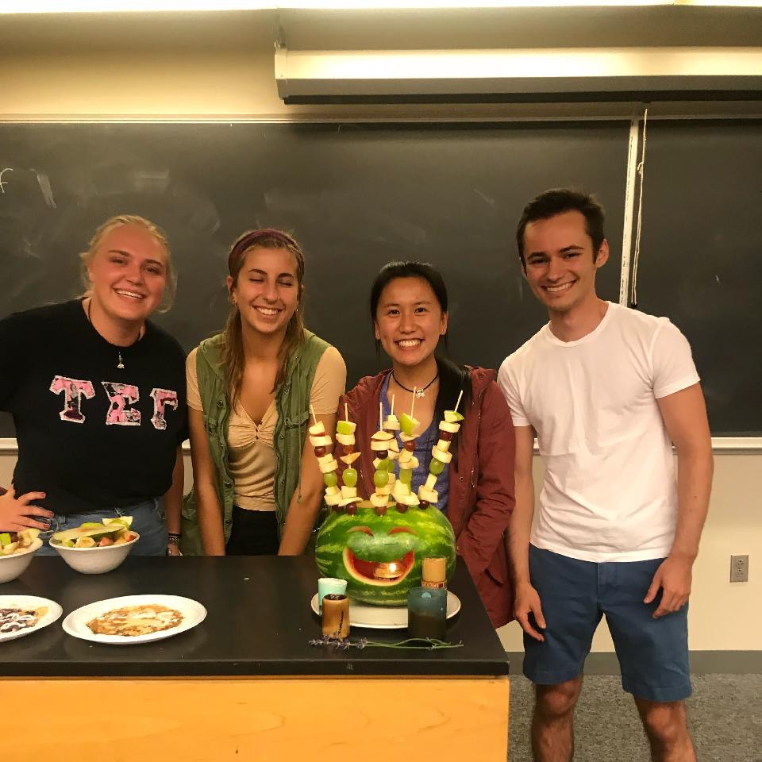
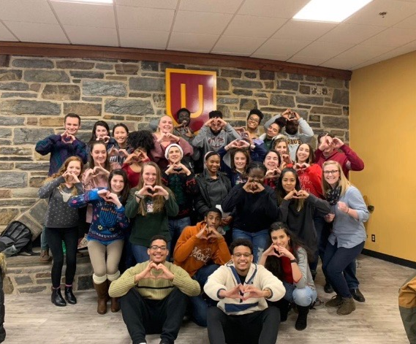
Year 1 -info session and interviews -Summer 2018 Orientation -CSS, Barnstone, Wismer on Wheels, WCMC, Camphill -Declare major: ANSO -Bon Din -

Slide 3
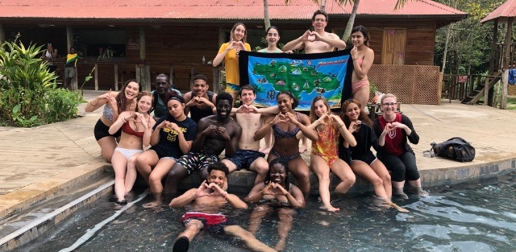
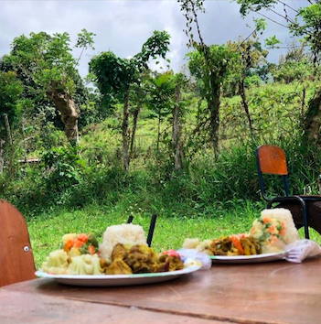
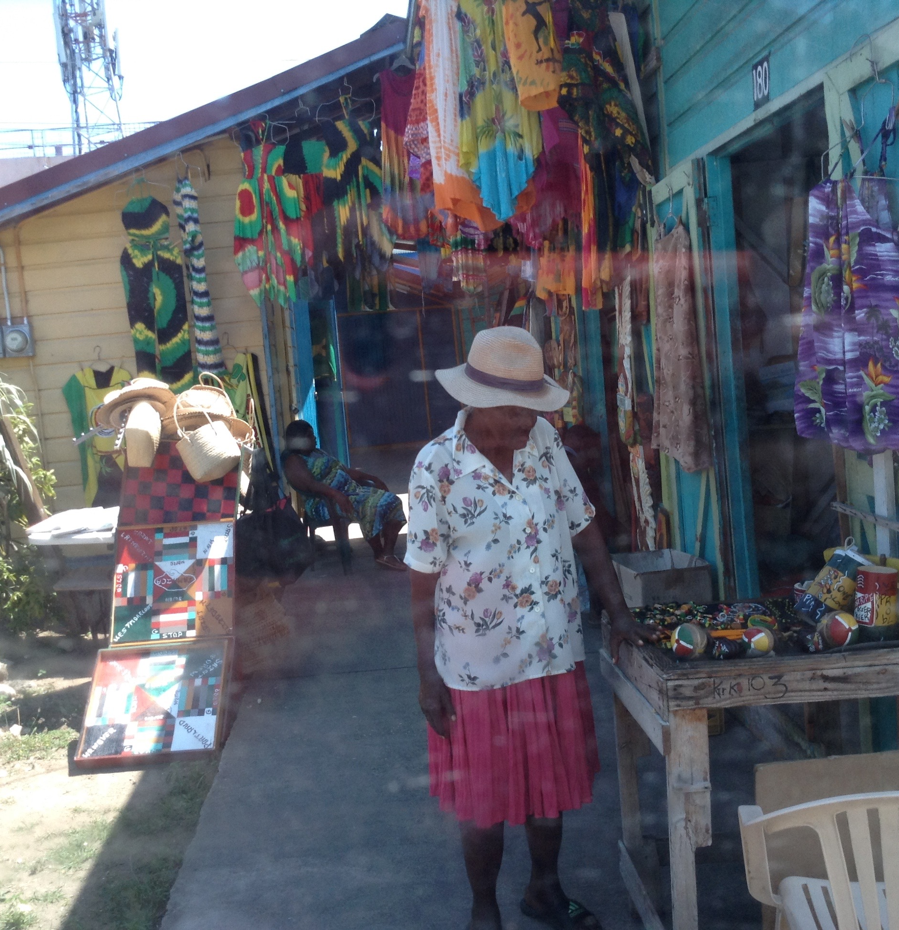
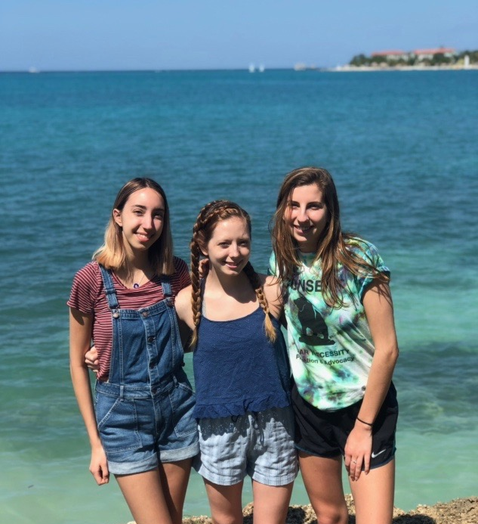
Jamaica
Cultural emersion
Spiritual exploration
Bonner bonding

Slide 4
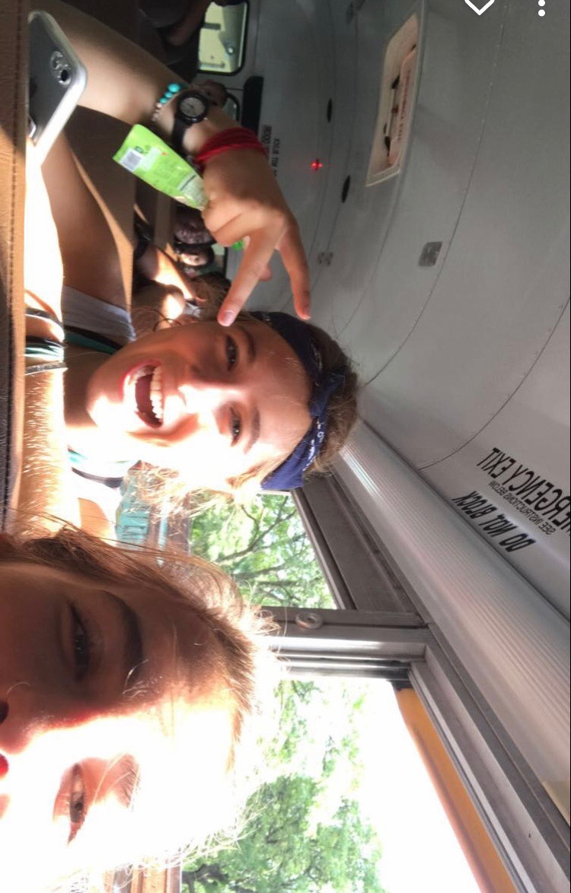
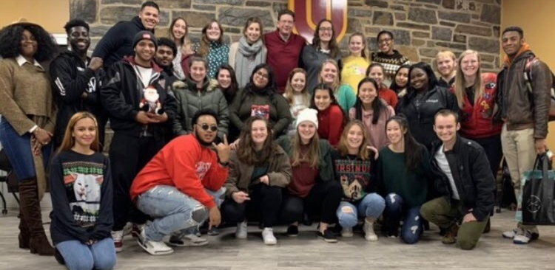
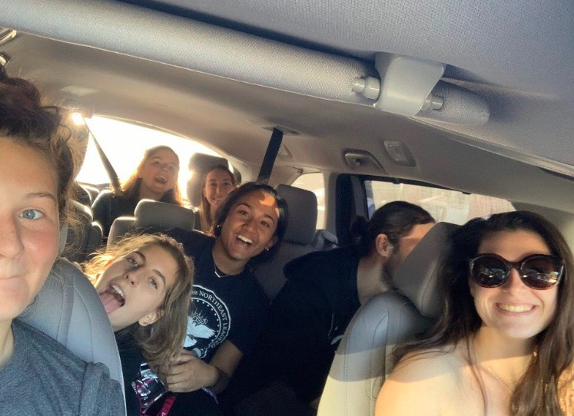
Year 2
Annual Bonner Holiday party
Early morning Bonner bus rides w/ Nole ‘20
Considering international perspectives
Take up new passions/leadership positions
Discover independence and confidence
Explore social justice in Independent Research
Driving home post tomato picking @ Camphill

Slide 5
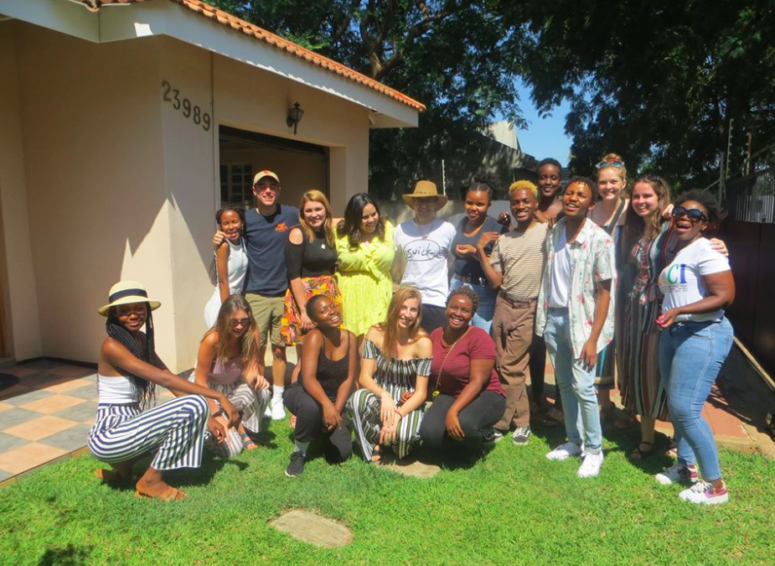
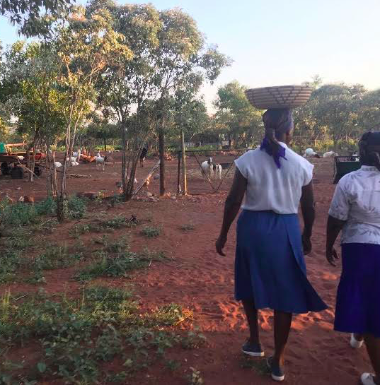
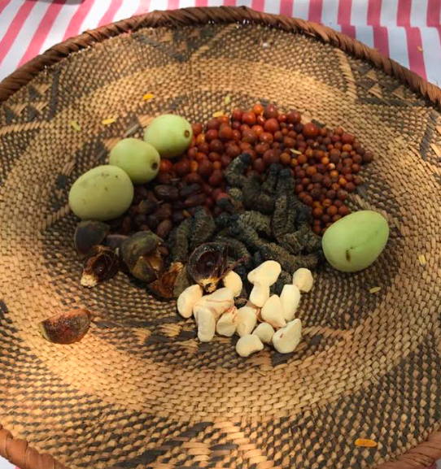
Study Abroad: Gaborone, Botswana

Slide 6
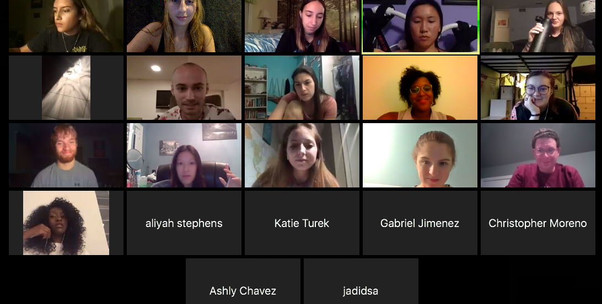
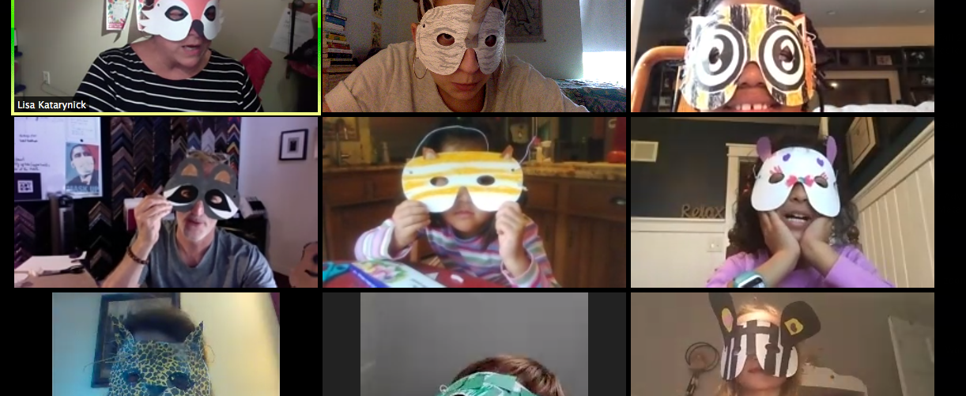
Year 3
COVID-19 blues
Adjusting to new way of communicating and connecting
Finding my place/role
Final ride

Slide 7
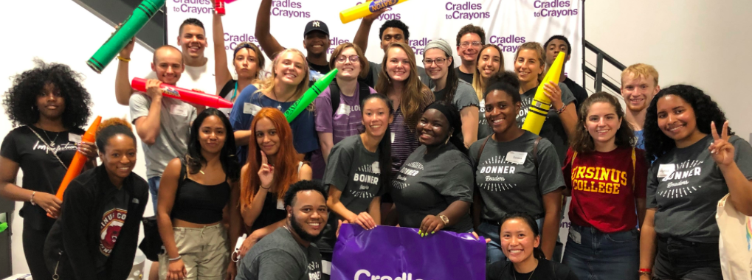
Thank you Katie, Christian, the Interns, and all fellow Bons! I’ll miss you!
Bonner Love forevaa>>

