Slide 1
Middle English “Tarantulas”: A New Edition of The Destruction of Jerusalem
Kara L. McShane, Department of English
Baden Lecture September 2020

Slide 2
What do you think of when I say “medieval England?”

Slide 3
What do you think of when I say “medieval England?”
Our notions are often based on medievalism – post-medieval depictions like fiction or film – that present medieval England as white, Christian, powerful.
The reality is far richer and more complicated, but these depictions essentially fall prey to medieval England’s propaganda about itself.
These notions have also influenced scholarly work – and teaching – about the Middle Ages.

Slide 4
Today:
An overview of my recent major project, a new edition of a Middle English poem called Destruction of Jerusalem
How does this poem fit into my scholarly trajectory?
Why is this poem important, interesting, troubling now?
An interactive intro to editing medieval texts
What’s it like to work with manuscripts?
What is the process from manuscript work to a finished edition?
What’s next

Slide 5
Destruction of Jerusalem
5100+ lines of rhyming couplets
Dating from (most manuscripts 15th century), 12 manuscripts extant
Last edited 1905 and remarkably understudied
The poem fictionalizes the Roman siege of Jerusalem in 70 CE.
The first part retells stories from the Christian Gospels about the death of Jesus.
Then the poem changes focus to talk about Vespasian, then-king of Gascony, who is healed by a lost messenger from Jerusalem. Upon being healed, Vespasian immediately vows to destroy Christ’s murderers.
He and his son Titus set out with an army for Jerusalem, where they besiege the city’s Jewish inhabitants for seven years.
The poem spends thousands of lines describing awful conditions in city, including moments of cannibalism and extreme deprivation, and celebrates Vespasian’s ruthless treatment of the citizens after the siege ends. In doing so, it amplifies both the violence and antisemitism of similar English narratives.

Slide 6
My research & Destruction of Jerusalem
My research reflects a long-standing interest in how literature of late medieval England seeks to engage in “history”/legend, especially how this literary output seeks to describe encounters with those it positions as “non-English.”
I am especially interested in how narratives explore language, including linguistic difference, and writing itself.
Medieval English antisemitism, and religious and contact/conflict more broadly, has been a central thread of my research.
Often – almost always – these texts are also working to create and promote narratives of Christian dominance and/or justify Christian violence.
While this poem is new (to me), these issues have been central to my work for my entire scholarly life (including my undergrad thesis!).

Slide 7
Why this poem? Why now?
Scholar Ralph Hanna famously calls Siege of Jerusalem, a similar narrative to Destruction, the “chocolate-covered tarantula” of medieval alliterative poetry. If so, this poem is just the tarantula.
Difficult medieval texts – like Destruction – are key to unpacking how Anglo-American white culture has constructed its mythologies of the past. Modes of thought like those that energized these works can be traced to contemporary acts of violence and efforts at Christian imperialism.

Slide 8
Activity: Intro to Medieval Textual Editing
You’re going into breakout rooms! Each group will have an image of a manuscript page to work with. Your tasks:
First, look at the whole page. What do you notice? What questions do you have about what you see?
Second, look closely at the first three or so lines on your page. (If you have two columns, go to the top left.) Can you read it? What distinct letters do you see? If you’re adventurous, take a stab at transcribing a line (or two).
https://docs.google.com/document/d/1AnfurbwkVzXxCGD_QWbPfbyakj6mG-M3vw4fc2zzMUU/edit?usp=sharing

Slide 9
What do you notice?

Slide 10
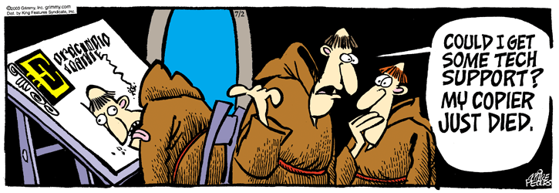
What do you notice?
Every manuscript is its own distinctive copy of a text: there is no authoritative version or single version in the modern sense. (We very rarely have author’s copies.) If there are twelve copies of your poem, there are twelve versions.

Slide 11
From manuscript to edition: Text
Transcription
Noting text exactly as it appears
Noting errors, damage, illumination
Collation:
Comparison across versions
Creation of base “working text”
Construction of textual notes capturing intriguing variants or emendations

Slide 12
Page proofs, The Destruction of Jerusalem, lines 1-15, ed. McShane & Wright (Forthcoming: Medieval Institute Publications)

Slide 13
From manuscript to edition: Notes
Left: page proofs of textual notes; Right: page proofs of explanatory notes

Slide 14
What’s Next?
Article currently under review
Presenting at New Chaucer Society Congress on editing difficult texts (2020 2021? 2022?)
Return to the manuscripts and signs of early modern use

Slide 15
Thanks are due…
Ursinus College Faculty Development
Collaborators Mark J. B. Wright, Bailey Ludwig
Colleagues of the English & History departments and my writing group (Profs. Lori Daggar & Rosa Abrahams)
Middle English Text Series, especially Pamela M. Yee, assistant editor
Students in ENGL 441W: Violence and Otherness in Medieval England
University of Michigan’s Drama Interest Group; the Rossell Hope Robbins Library at the University of Rochester; staff at the Bodleian Library, the British Library, the Beinecke Library, and the Pierpont Morgan Library
Karen, Alexander, & Freddie McShane for practical and emotional support
All of you for your presence!

